Slide 1


Napa County
Travel Behavior Study
Napa County Joint Board of Supervisors and Planning Committee Meeting Presentation
March 10, 2015

Slide 2
Overview
Objectives of the Study
Community Advisory Committee
Study Approach
Data Analysis and Integration
Conclusions

Slide 3
Objectives of the Study
Gather information on the travel behavior of visitors, employees, residents, and students who make work and non-work trips in Napa County
  Use the information to help answer questions, expand transit and paratransit services, and inform the Travel Demand Model
An opportunity to integrate innovative data collection methods with enhancements to traditional methods to offer an unprecedented look into travel behavior in Napa County
    A multi-firm team comprised of Fehr & Peers, StreetLight Data, and MioVision was created

Slide 4
Community Advisory Committee
Fehr & Peers worked with NCTPA staff to convene a Community Advisory Committee
  Comprised of representatives from business and wine industry groups, major employers, and other community stakeholders
  We understood the importance of effectively reaching out and engaging members of the community

Slide 5
Study Approach
Utilized and combined results of five data collection methods
  Vehicle Classification Counts
  Winery Regression Analysis
  License Plate Matching
  In-Person Winery, Mail, and Online Employer Surveys
  Mobile Device Data

Slide 6
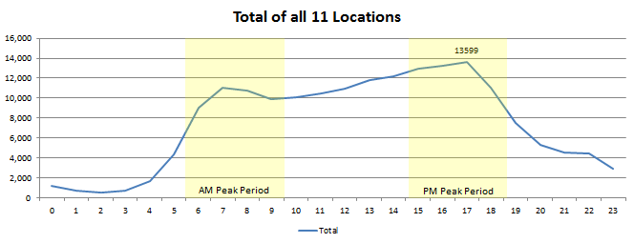
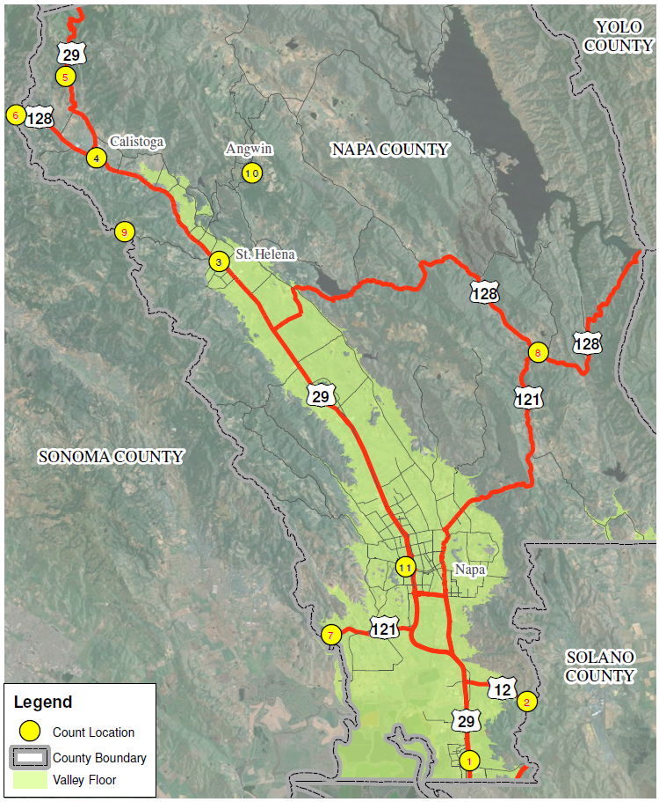
Study Approach
Vehicle Classification Counts
  11 survey data locations including all 7 external gateways
  126,736 total vehicles at the 7 external gateways (inter-county trips)
  4-Hour AM peak period – 23% of daily
  4-Hour PM peak period – 28% of daily
  AM peak hour – 6%, PM peak hour – 7%
  AM – 58% inbound, PM – 56% outbound

Slide 7
Study Approach
SR 12 Jameson Canyon Road Widening Project
  Collected counts on Friday, October 24, 2014 (more than one full month after the completion of the project)
    SR 29 North of American Canyon Road
    SR 12 at the Napa/Solano County Line
  Compared to traffic count data on Friday, October 4, 2013
    SR 12 - 4,300 daily vehicles or 14% increase
    SR 29 - 4,600 daily vehicles or 9% decrease
    Roughly 4,000 vehicles may have shifted their traffic pattern

Slide 8
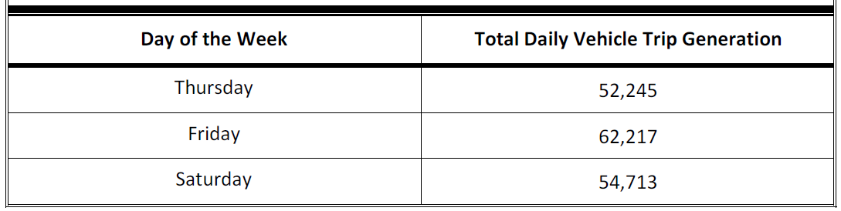
Study Approach
Winery Regression Analysis
  Used simple linear regression analysis to estimate trip generation for 434 winery parcels
  Impractical and unable to collect driveway counts at all 434

Slide 9
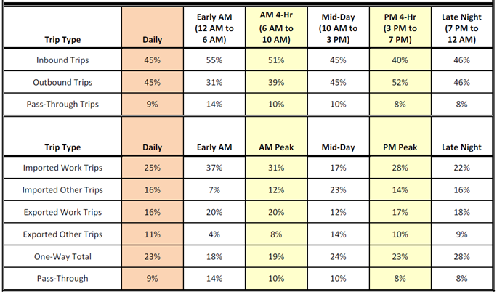
Study Approach
License Plate Matching

Slide 10
Study Approach
In-Person Winery, Mail, and Online Employer Surveys
  21% of winery patrons were from the Bay Area, 10% from outside the United States
  35% of winery patrons started their day in Napa County, 23% in San Francisco
  32% of employer survey respondents live and work in the City of Napa
  61% of employer survey respondents use SR 29 to travel to work
  20% of employee survey respondents carpool (this includes taking kids to school)
  43% of employee survey respondents said they would use public transit if expanded
  97% of employee survey respondents use their personal automobile to commute
  37% of mail survey trips ended in Napa, 19% in St. Helena, and 7% in Calistoga
  21% of mail survey trips were said to be made “less than one time per month”

Slide 11
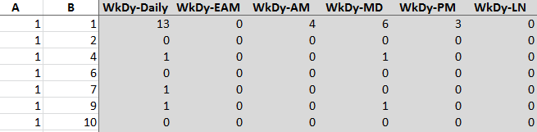
Study Approach
Mobile Device Data
  206,152 data samples vs. 1,800 survey responses
  45% touched an external gateway (inter-county trip that we have a control total for)
  9% were pass-through trips (matches license plate matching)
  55% were internal trips (almost impossible to measure with traditional methods)

Slide 12
Data Analysis and Integration
Started with Mobile Device Data due to large sample size of origin-destination data
Other data used to refine the origin-destination trip tables to represent single days of absolute data
Resulting trip tables represent a single meaningful dataset of all data collected

Slide 13
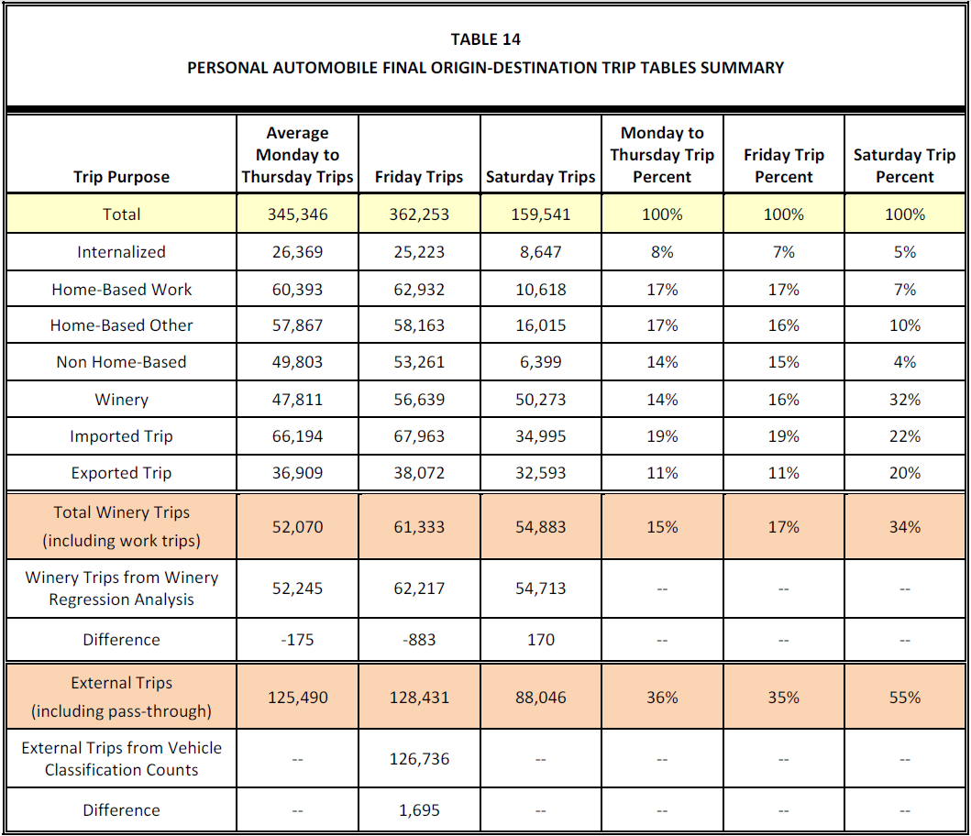

Slide 14
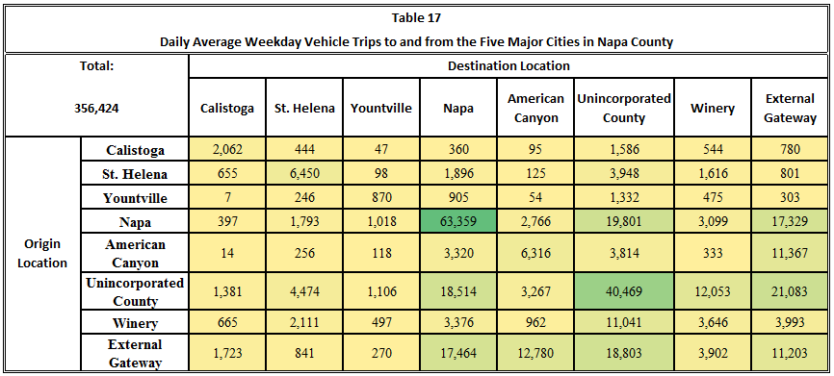
Origin-Destination trip data can be aggregated to any desired level to illustrate larger travel patterns such as flows to and from the five major cities in Napa County

Slide 15
Conclusions
The Napa County Travel Behavior Study provides NCTPA with several data sets. Data highlights that may be useful for future planning efforts include:
From Winery Regression Analysis
  Napa County wineries generate an estimated 62,200 vehicle trips on a Friday in October
From License Plate Matching
  9% of daily trips at Napa County external gateways are pass-through trips
  52% of Napa County pass-through traffic travels from the Sonoma County line on SR 12 to the Solano County line on SR 12
  41% of daily trips are imported trips and 27% are exported trips
  23% of traffic was one-way (a portion of this is visitors)
  21% of total daily trips into Napa County were “visitor” trips

Slide 16
Conclusions
From Surveys
  21% of winery patrons were from the Bay Area, 10% were from outside the United States
  35% of winery patrons started their day in Napa County, 23% in San Francisco
  32% of employer survey respondents live and work in the City of Napa
  61% of employer survey respondents use SR 29 to travel to work
  20% of employee survey respondents carpool (this includes taking kids to school)
  43% of employee survey respondents said they would use public transit if service expanded
  21% of vehicle intercept survey trips were said to be made “less than one time per month”
From Mobile Device Data
  55% of daily trips were internal to Napa County
  9% were passing through Napa County

Slide 17
Questions?

