Slide 1
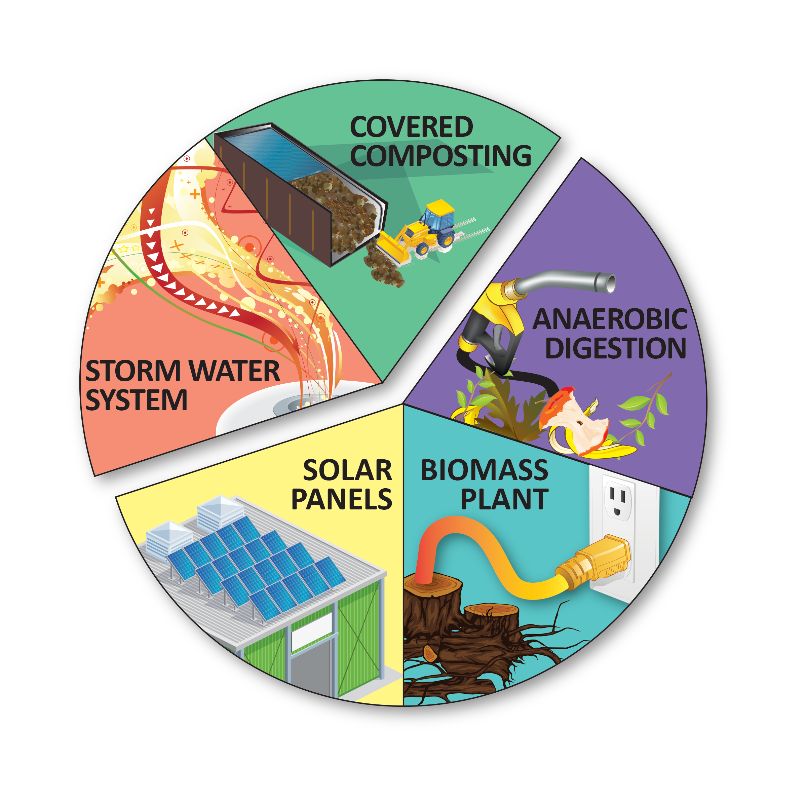
Overview of NRRP Elements by 2020
$6M–$8M
Stormwater System Improvements and a Covered Composting System are necessary upgrades at the MDF
within the
next 1–3 years.
$1.5M–$2M
$13M–$15M
Anaerobic Digestion, Biomass Plant and Solar Panels represent
local and sustainable renewable energy opportunities (but not requirements) by 2020.
$6M–$7M
$1M–$1.5M

Slide 2
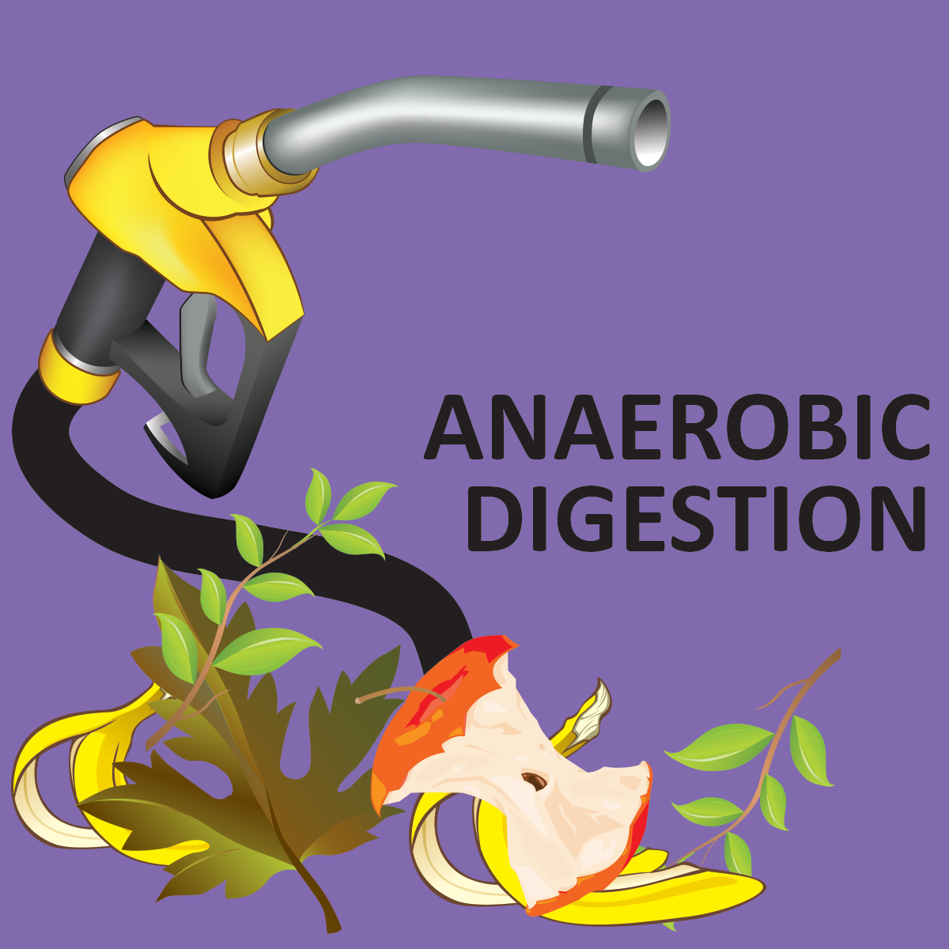
$15M Anaerobic Digestion (AD) to Biofuel System at City MDF
This “air-less” technology ferments a mix of plant/food materials to create renewable biomethane or “biogas”
City received a $3M grant from California Energy Commission for a 25,000 tons/year system to capture biogas and produce 328,000 diesel gallon equivalent of biofuel for refuse fleet.

Slide 3
AD to Biofuel system at Mdf –
Summary of Major benefits
Clean Air = 100% clean air “carbon-negative” refuse & recycling fleet not vulnerable to market price fluctuations/foreign conflicts
Local & Renewable = A true “Closed Loop” sustainable local collection infrastructure (collected organics as feedstock to provide fuel for vehicles; “fork to fuel”) not reliant on “fracking”
Best Available Technology = Utilizes best available technology for air emissions, odor reduction and stormwater management
Sustainability Fulfillment = Significant fulfillment of both City and community-wide sustainability plans. AD to biofuel system reduces City emissions by over 30% compared to present transportation-related air emissions from City operations.

Slide 4

…and the Bonus!
At full capacity, the Napa AD to biofuel system would prevent 78,900 metric tons of CO2 from be released over 20 years which is the equivalent of taking 830 passenger vehicles off the road each year for 20 years

