Slide 1


Napa County Supervisors
Napa County Wine Business
Rob McMillan, EVP and Founder, Wine Division

Slide 2
Rob McMillan - Curriculum Vitae‎
EVP & Founder, Silicon Valley Bank’s Wine Division
Published author of numerous reports on industry trends used in Universities in the US and throughout the World.
Subject matter expert cited in CNBC, LA Times, PBS, Barron’s, Forbes, NBC Universal, NY Times, Wine Spectator, Decanter, and many others
Managing Committee Silicon Valley Bank 1999-2002 (NASDAQ: SIVB)
Worked in the wine business since 1981. Lives and has worked in the Napa Valley since 1996

Slide 3
US Wine Consumption - Forces Leading to Channel Shifts
9-11 & Tech Recession
Granholm Decision
End of 2 Martini Lunch
Distributors: Too Much Inventory
Million Gallons
Winery Definition Ordinance
Internet Shopping
Grape Shortage
Wholesalers Consolidate
Grape Excess
Wholesalers Exit Accounts
Direct Sales Accelerate
Wine Clubs Grow
Wholesalers Open Fine Wine Arms
Source: CA Wine Institute & SVB Research

Slide 4
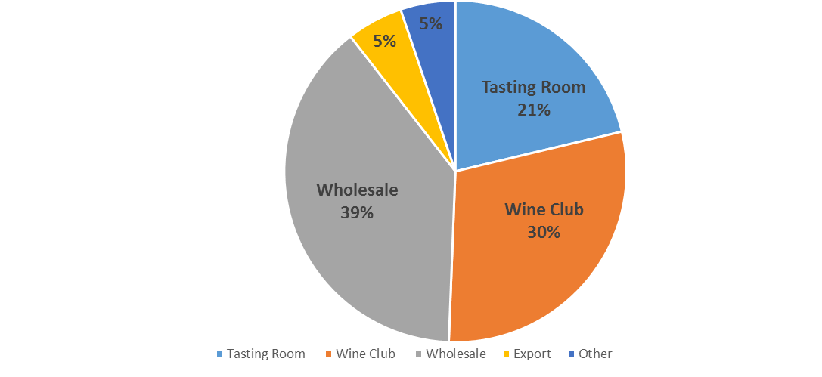
2015 Napa County Wine Sales Channels
“Other” includes internet and phone sales
56% Of Avg. Sales Are Now Direct
39% Of Avg. Sales Thru Wholesale
Source: 2016 SVB Wine Conditions Survey

Slide 5
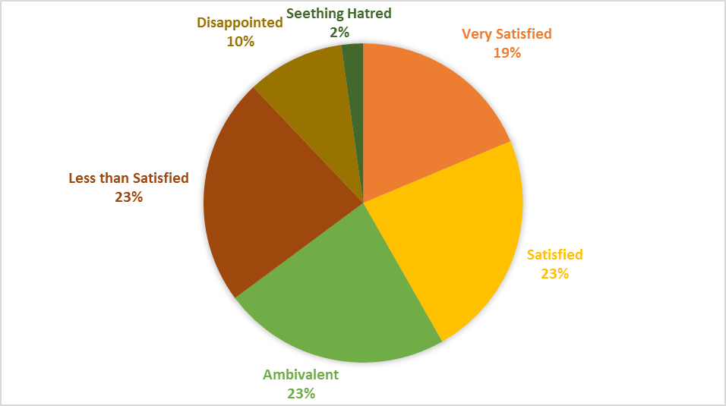
Satisfaction with Wholesale Arrangements
62% Ambivalent or Not Satisfied
42% Satisfied
Source: 2016 SVB Wine Conditions Survey

Slide 6
How Are Napa Wines Sold?

Slide 7
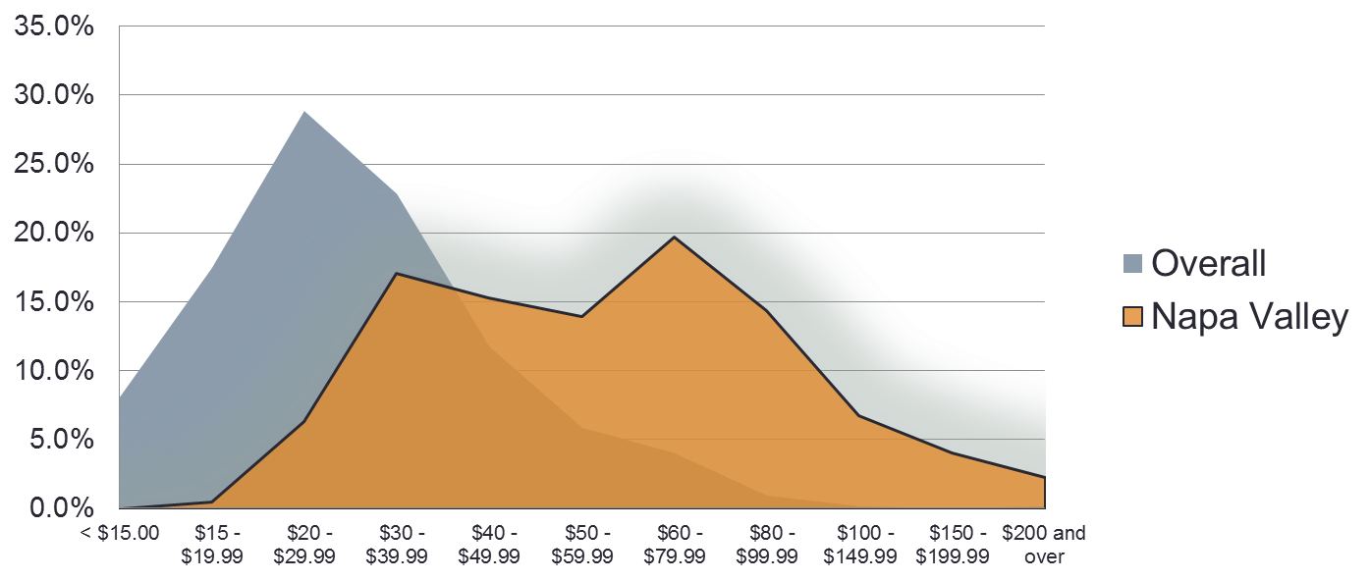
Napa Valley Bottle Prices Are Higher Than The Industry Overall
Source: Silicon Valley Bank 2014 Tasting Room Survey

Slide 8
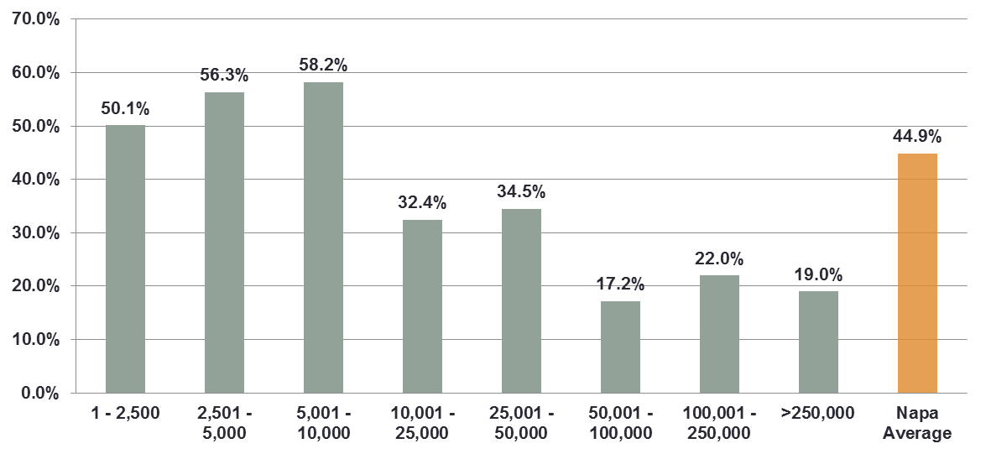
Almost 60% of Average Sales under 10K Cases in Napa Are Direct
Source: Silicon Valley Bank 2013 Tasting Room Survey

Slide 9
What do Consumers Expect When Buying Napa Wine?
The Lowest Price?
Unobtainable Wine?
Perceived Quality
(Brand Strength)
x
Experience
Value
=
__________________________
Price

Slide 10
How Much Do Napa Wineries Make?

Slide 11
Profitability of Average Napa Wineries
Source: Silicon Valley Bank

Slide 12
Tasting Room Dynamics

Slide 13
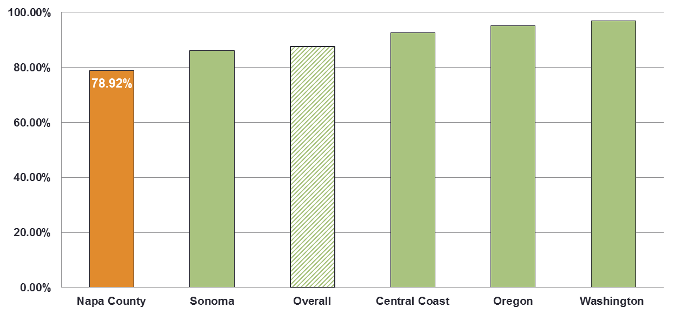
Napa Has a Slightly Lower Percentage of Tasting Rooms Compared to Other Regions

Slide 14
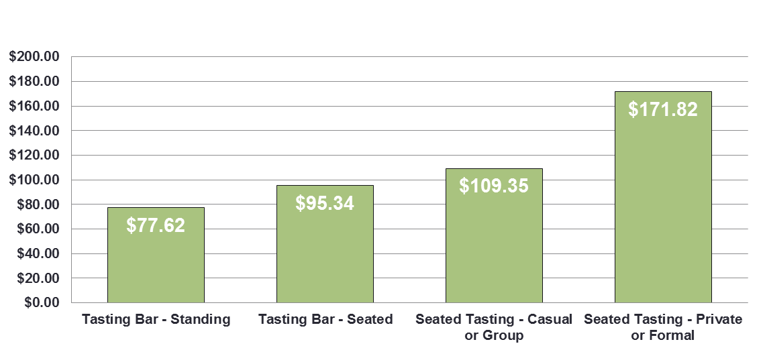
On Average, Seated Tastings Result in Higher Purchases
Source: Silicon Valley Bank Proprietary Research

Slide 15
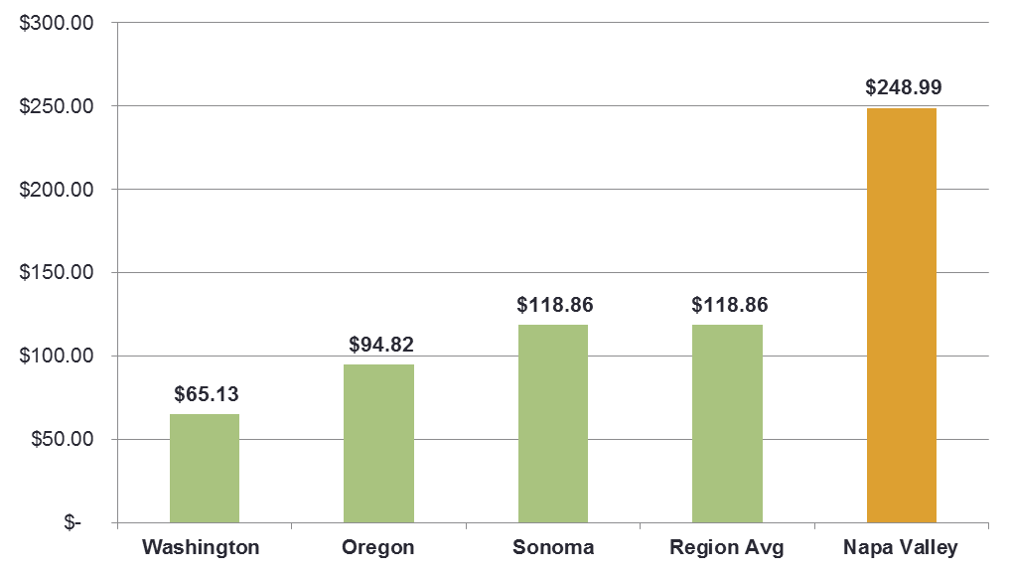
Napa Valley Wines Have the Highest Average TR Purchase
Source: Silicon Valley Bank Proprietary Research

Slide 16
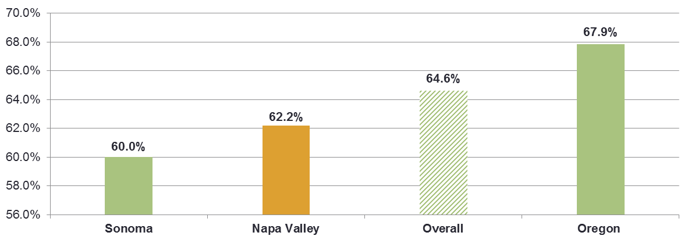
Average Conversion of Tasting Room Visitors to Purchase
Source: Silicon Valley Bank Proprietary Research

Slide 17
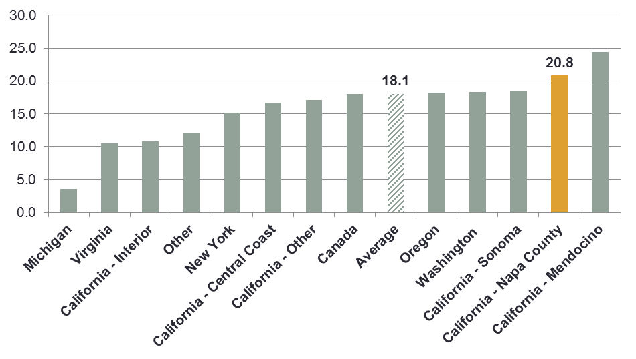
Average Length of Wine Club Memberships
Months

Slide 18
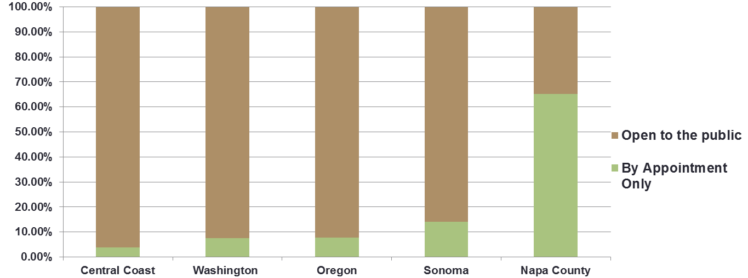
Napa Has the Highest Percentage of By Appointment Tastings
Source: Silicon Valley Bank Proprietary Research

Slide 19
Summary
Direct sales are not the first choice of wineries
Napa wines are hand-sold as Luxury Goods, requiring “experience” as part of the equation.
56% of the average Napa Winery’s Sales come Direct
Consumers stay in a wine club less than 2 years
The best source of new club members is the tasting room
Most small family wineries in Napa will not survive profitably without an increasing emphasis on DtC sales

Slide 20
Questions
RMcMillan@SVB.com
www.SVBonWine.blogspot.com

