Slide 1
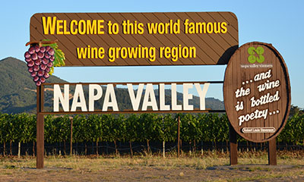
NAPA COUNTY PLANNING COMMISSION
February 17, 2016
THE BUSINESS OF THE NAPA VALLEY WINE BUSINESS
Richard Mendelson
Rob McMillan
Craig Underhill

Slide 2
Background
Attorney, Dickenson, Peatman & Fogarty since 1986, specialist in wine law, land use and intellectual property.
Director, Wine Law and Policy Program, University of California Berkeley since 2007, teach classes on “Wine Law” and “Products of Place.”
Author, From Demon to Darling: A Legal History of Wine in America (UC Press 2009), Wine in America: Law and Policy (Wolters Kluwer 2011), and Appellation Napa Valley: Building and Protecting an American Treasure (Val de Grace, April 2016).
Visiting Professor, Universities of Bordeaux and Aix-Marseille (Vineyard and Wine Law Degree Programs), University of California Davis School of Management (Wine Executive Program), Sonoma State University (Wine MBA).
Past President, International Wine Law Association; chair, annual CEB California Wine Law Forum.

Slide 3
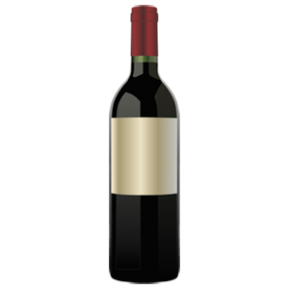
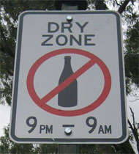
Wine is not like milk
3
≠
  Prohibition - Free movement of goods…
  18th / 21st Amendments: Commerce Clause of the U.S.
  highly regulated at the Constitution
  federal, state and local levels!

Slide 4
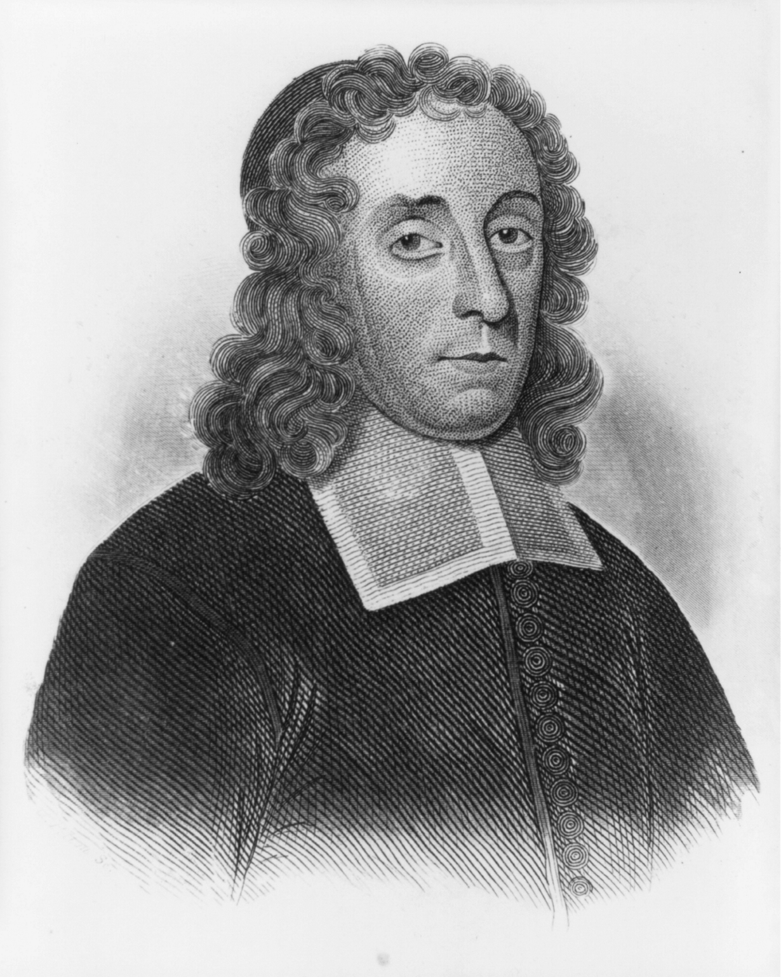
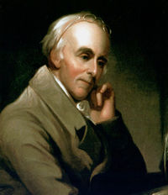
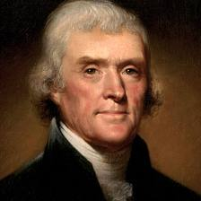
The Search for Temperance &
The Road to Prohibition
“The Wine is from God, but the Drunkard is from the Devil.” Wo to Drunkards (1673)
_{Increase Mather}
An Inquiry into the Effects of Ardent Spirits upon the Human Body and Mind (1811)
_{Dr. Benjamin Rush}
“No nation is drunken where wine is cheap, and none sober where the dearness of wine substitutes ardent spirits as the common beverage. Wine brightens the life and thinking of anyone.”
_{Thomas Jefferson}

Slide 5
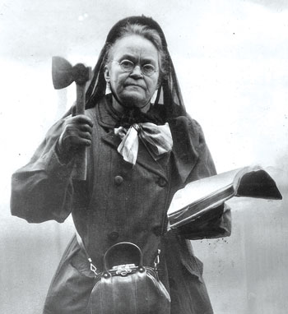
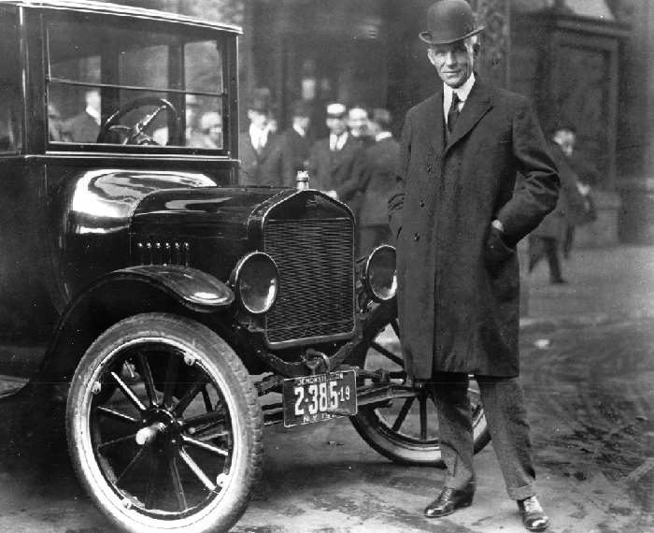
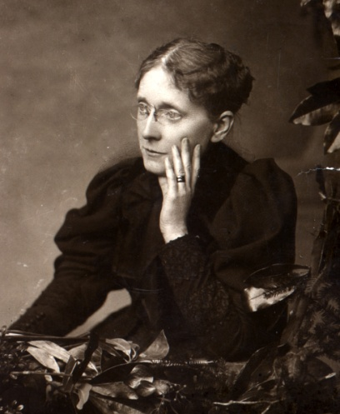
The Search for Temperance &
The Road to Prohibition
Carrie Nation
(1846 – 1911)
Frances Willard
(1839-1898)
Henry Ford (1863 – 1947)

Slide 6
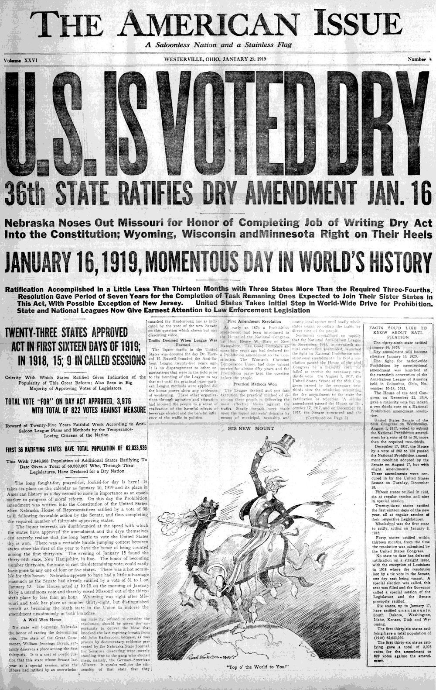

National Prohibition:
18th Amendment, 1920-1933
6
“The manufacture, sale or transportation of intoxicating liquors within, the importation thereof into, or the exportation thereof from the United States for beverage purposes is hereby prohibited.”

Slide 7
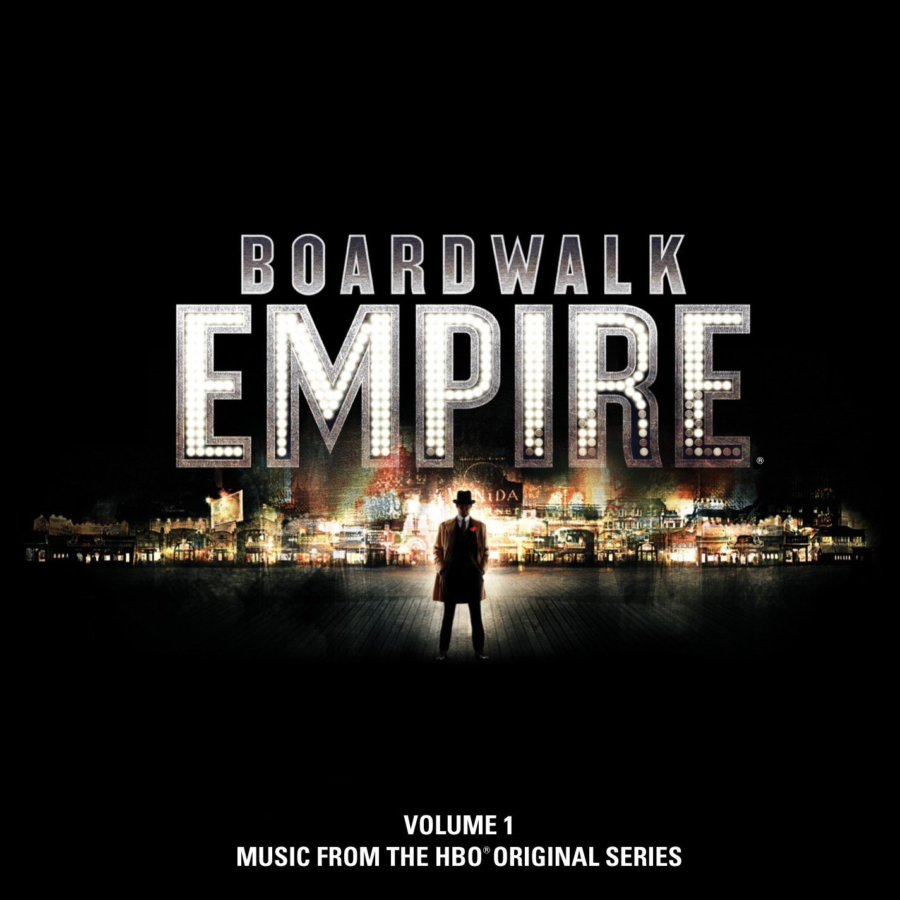

Slide 8
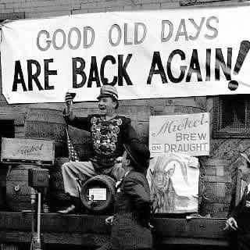
U.S. Constitution:
21st Amendment (1933)
Section 2. The transportation or importation into any State, Territory, or possession of the United States for delivery or use therein of intoxicating liquors, in violation of the laws thereof, is hereby prohibited.

Slide 9
State Law

Slide 10
Ensuring an Orderly Market:
Three-Tier System of Distribution
State A
Winery / Importer
Wholesaler
Retailer
Consumer
State B
Winery / Importer
Wholesaler
Retailer
Consumer

Slide 11
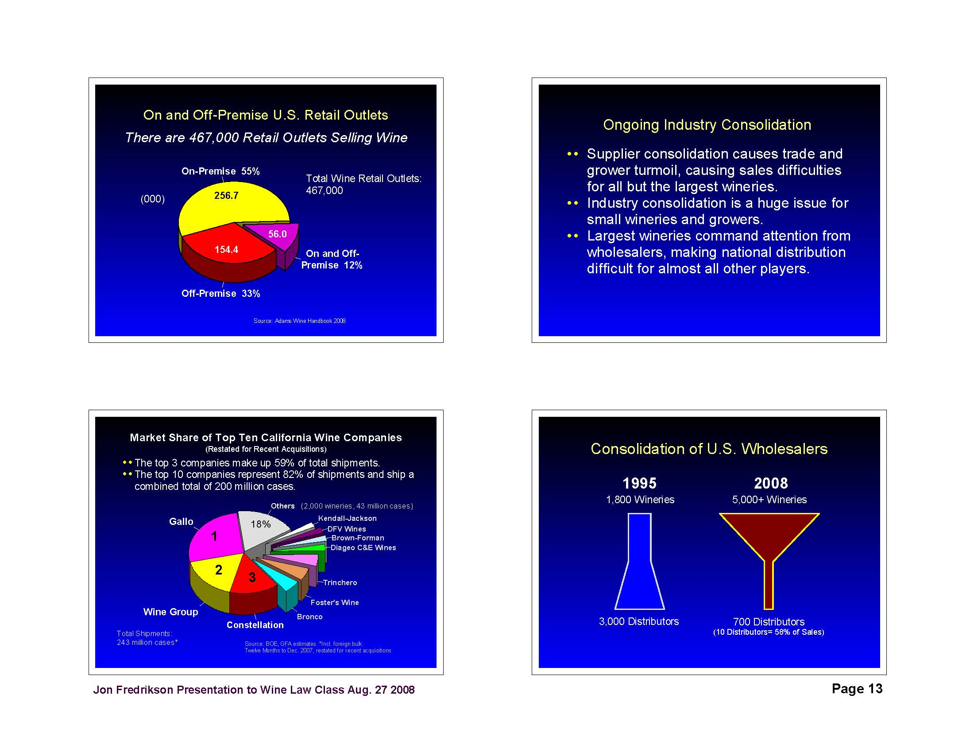
2015
8,600 Wineries
675 Distributors
(Top 4 = 60% of sales)

Slide 12
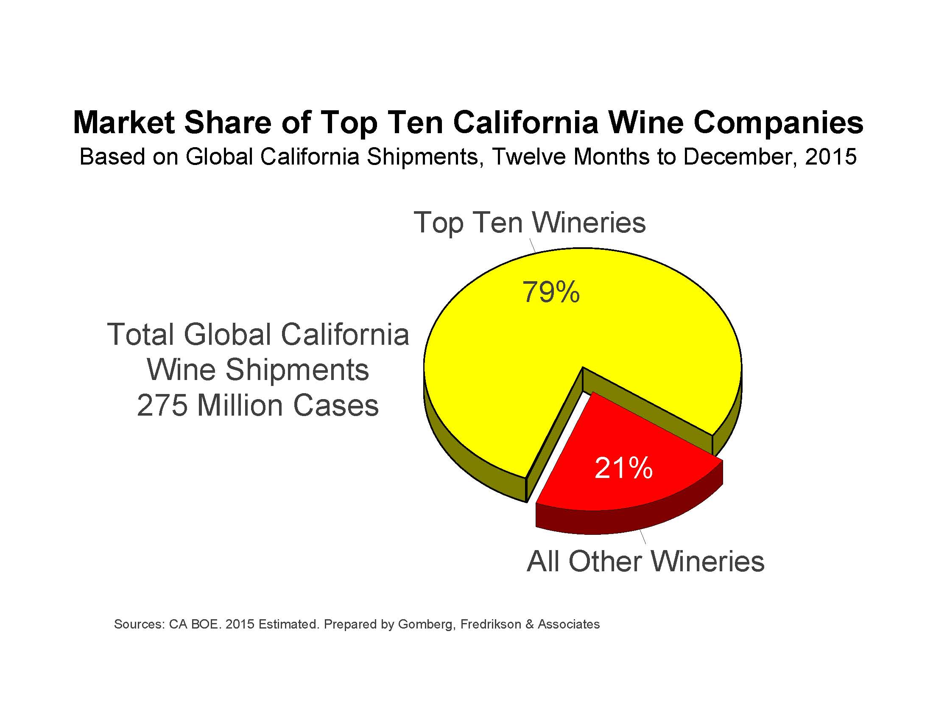

Slide 13

Opening New Sales Avenues:
Direct to Consumer (DtC)
Not a new concept: “farm winery” (NY, 1970s); San Franciscans traveled to Napa Valley pre-Prohibition to buy their wines directly from our wineries.
Rise of the Internet (1990s)
U.S. Supreme Court: Granholm v. Heald (2005)
  “States cannot permit in-state wineries directly to ship alcohol to in-state consumers but restrict the ability of out-of-state wineries to do so.”
Wholesaler consolidation
Global competition

Slide 14
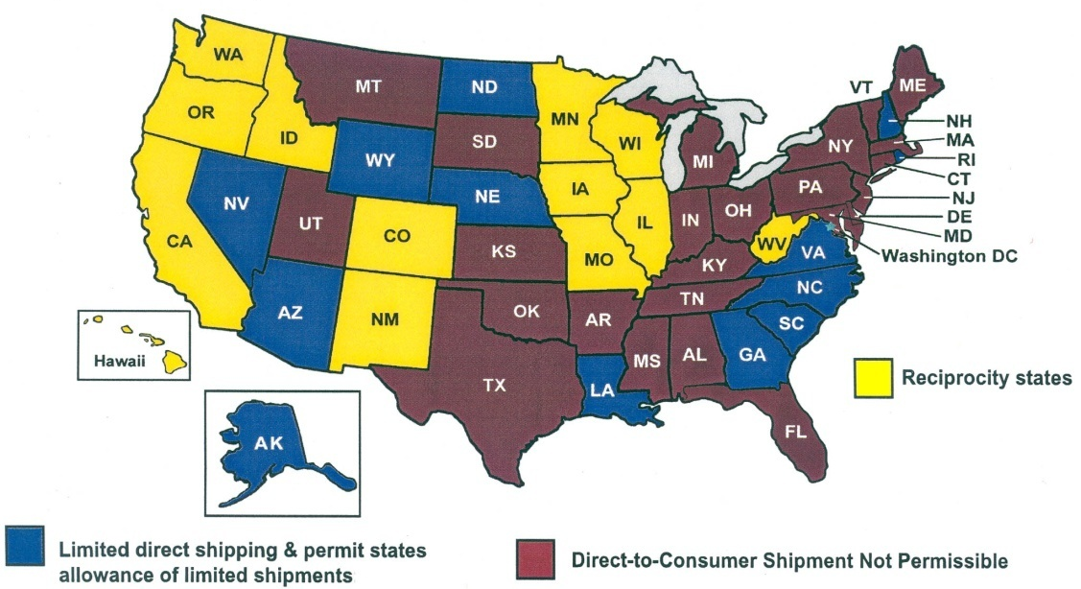
2004 v. 2014: The Effects of Granholm v. Heald
Today, wineries can ship wine directly to @85% of adult Americans.
DTC allowed DTC prohibited

Slide 15
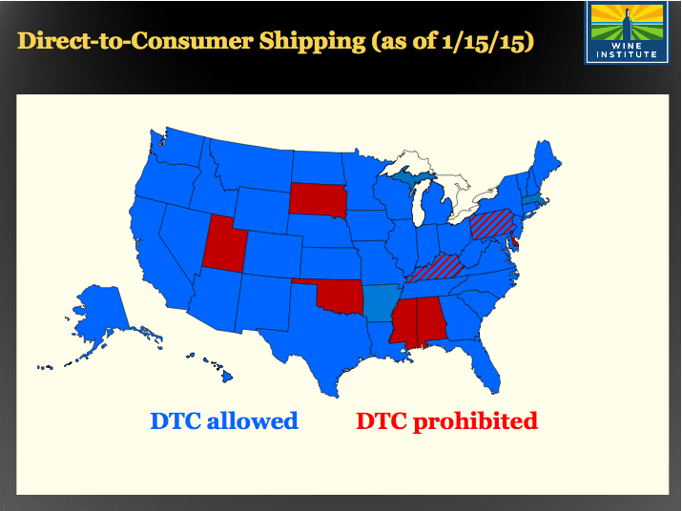

Slide 16
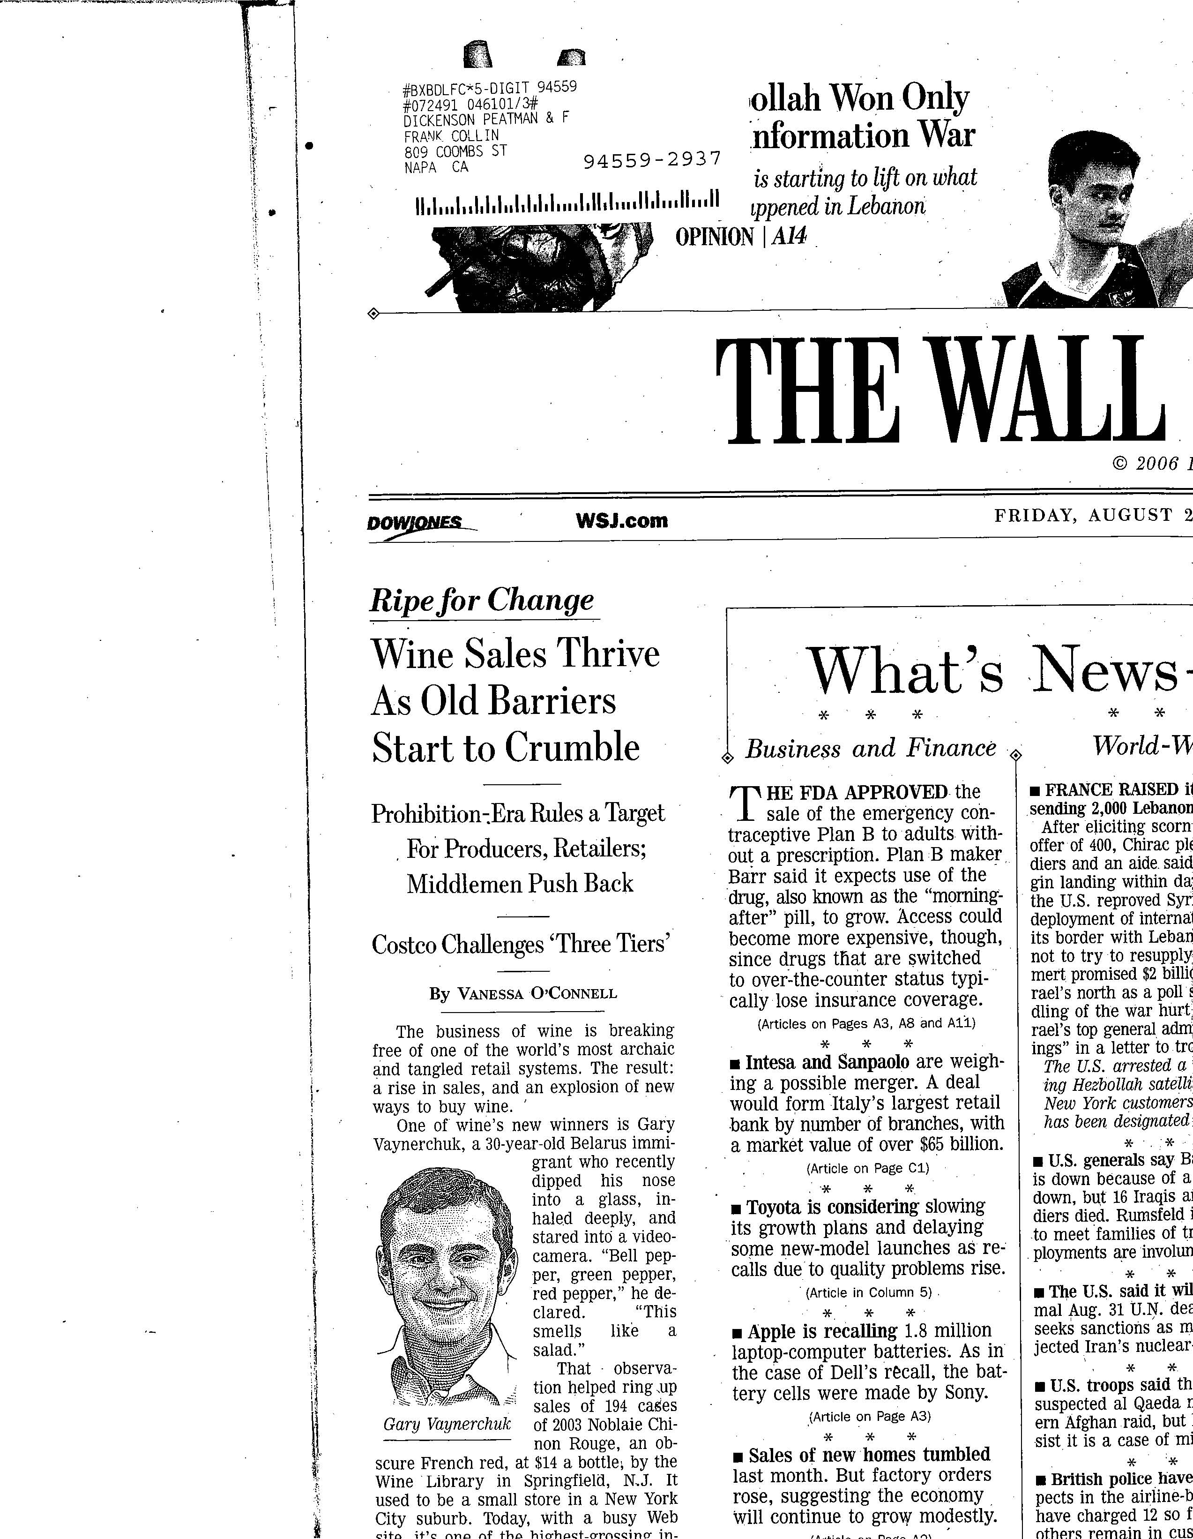
Wall Street Journal, page one, August 25, 2006
16
16

Slide 17
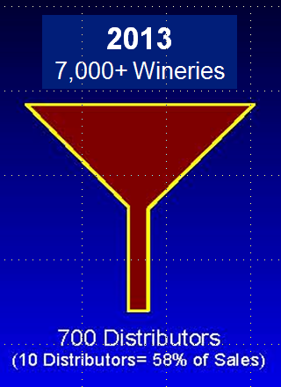
Conclusion
2015
8,600 Wineries
DTC allowed DTC prohibited
675 Distributors
(Top 4 = 60% of sales)

Slide 18
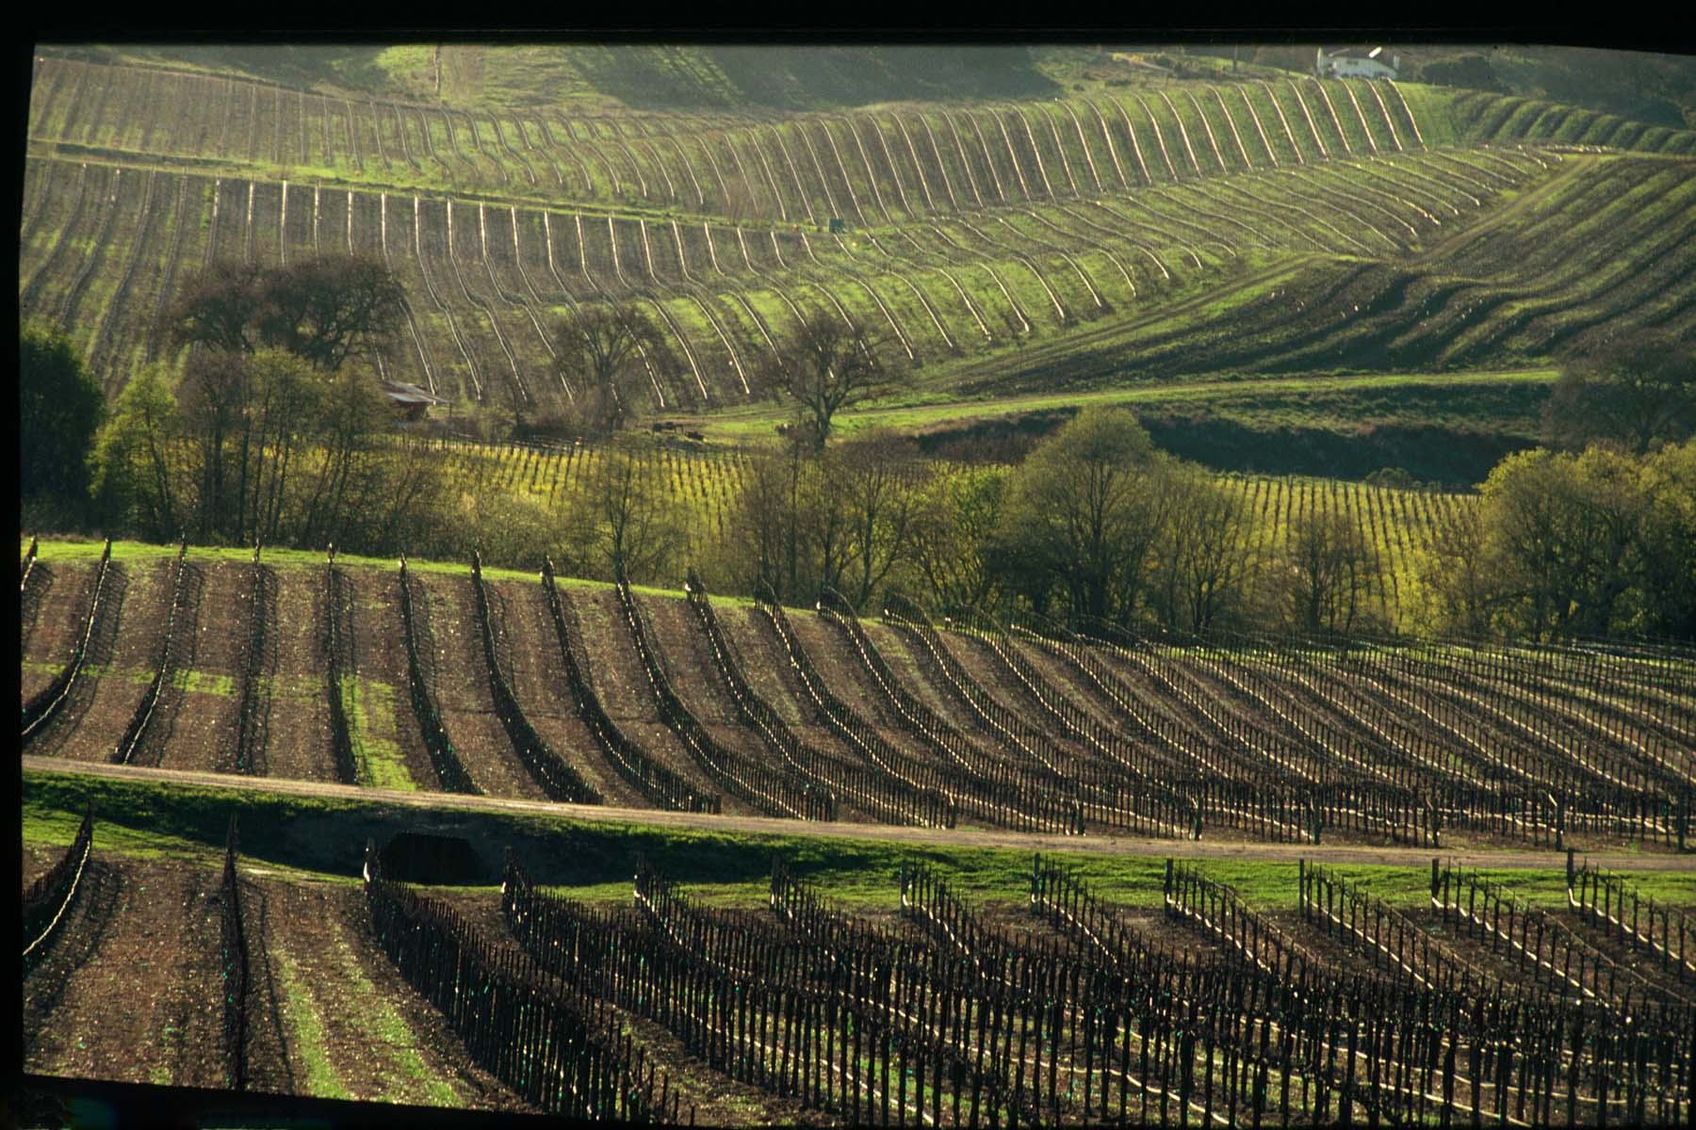
Thank you
Richard Mendelson
Rob McMillan
Craig Underhill

