Slide 1

Department of Public Works
NVTA Countywide
Pedestrian Plan of July 2016
November 2, 2016
Planning Commission
PC review ped plan.pptx

Slide 2
Plan Development
NVTA selected consultant
  Worked with staff from NVTA and agencies
  Public participation
    Workshops held Winter 2015
    Online comment tool
CEQA review by NVTA
NVTA Board
  Adopted July 20
Notes:
Consultant, Fehr & Peers, SF
Workshops were held in SH, YV, Napa, AC;
Cali had similar workshops recently so not during this process

Slide 3
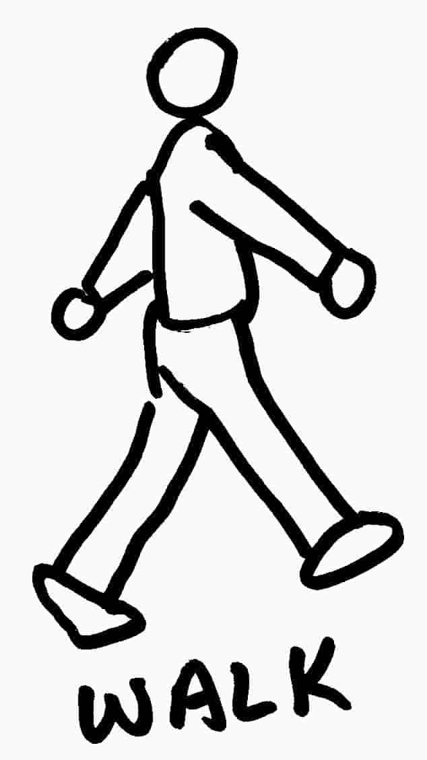
Plan Components
Countywide Plan (overview)
  Vision, Goals, Policies
  Walking trends
    Forecast demand
    Collision trends
6 Community Plans
  4 cities
  1 town
  Unincorporated area
Notes:
This organization scheme is just like the Bike Plan

Slide 4
Vision
To provide a pedestrian network that is well connected, safe, and enjoyable for Napa County residents and visitors of all levels of mobility
Increase the number of pedestrian trips
Non-motorized modes
  Widely available
  Accessible
  Convenient
Easy walking access to community, services and amenities
Notes:
Full text: “To provide a pedestrian network that is well connected, safe, and enjoyable for Napa County residents and visitors of all levels of mobility. This plan aims to increase the number of pedestrian trips and to set the groundwork for a shift in travel mode choice such that non-motorized options are widely available, accessible, and convenient. Through implementation of this plan and future updates, all Napa County residents, regardless of age or income level, should have easy walking access to their community and the services and amenities that it offers.”

Slide 5

Goals
Provide connected network
  Safe and accessible – variety of users
  Foster community interactions
Encourage multimodal transportation
Obtain funding for ped projects
Encourage and educate residents
  Enforce safe interactions peds/motorists
Notes:
Policies
1A. Protect character and context of the County and its jurisdictions
1B. Prioritize safe routes to school, transit, seniors
1C. Acknowledge central role of Vine Trail, prioritize connections to key destinations
1D. Connect key ped desire lines – focus on downtowns, transit, schools, seniors and tourists
2A. Current design standards in plan and other sources
2B. Performance measures like multimodal LOS
2C. Prioritize projects that increase walk mode share, take advantage of available funding
2D. Creative parking measures – shared, max #s, “park once” environment
2E. Review new development – ped access maintained or improved, including during construction
3A. Allocate CIP $ to ped projects
3B. Pursue grant funding
3C. Identify new funding and partnership opps
4A. Increase public awareness of ped facilities, amenities and safety
4B. Pursue Walk-Friendly Community status
4C. Implement ongoing safety enforcement
4D. Partner with health agencies to encourage youth
4E. Collaborate with local businesses – wayfinding and streetscape

Slide 6

County Plan
Evaluation of existing plans, policies and programs
Inventory of existing facilities
Existing activity levels
Collision history
“Walk Audit”
Recommended
best practices
Notes:
Evaluation called “benchmarking” – identifies Key Strengths, Enhancement Areas and Opportunity Areas
Key Strengths – collision reporting, demand management, coordination with health agencies
Opportunities – inventory of facilities, count ped volumes, adopt formal crosswalk policy
Full list of all benchmarking results in County appendix
Consultant inventoried 50+ miles we identified, created GIS layer for our ongoing use
Counts performed in Angwin, collisions reviewed
Best practices (more on next slides)

Slide 7

Walk Audit
Angwin selected for unincorporated area
Stakeholders – County, schools, NVTA
Recommended improvements
Serve as a template for other areas
Notes:
Angwin was selected based on input received from the public outreach process
School reps included County Office of Education (Safe Routes to School program) as well as Howell Mountain Elementary and PUC
Recommendations on later slide
Process will be able to be used for other areas

Slide 8
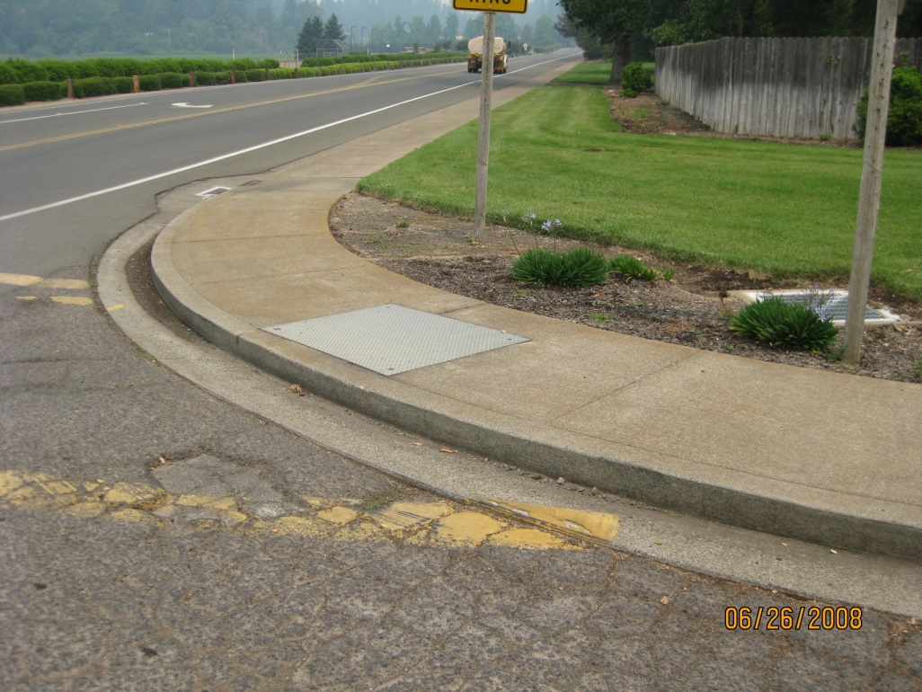
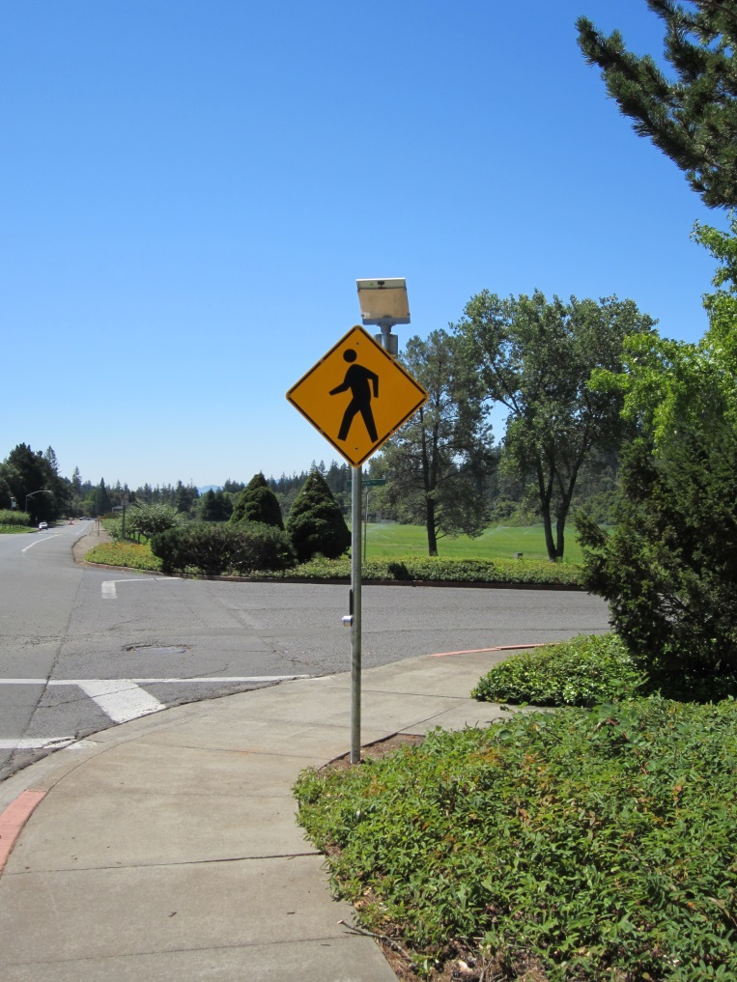
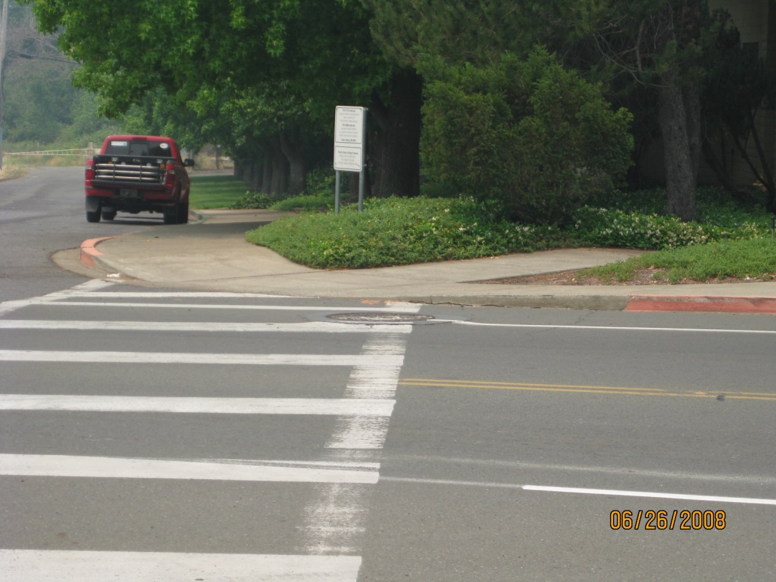
Walk Audit
Notes:
Here are some existing ped features in central Angwin
Sidewalks with out-of-date curb ramps or none altogether; some recent improvement to enhance crossing awareness

Slide 9
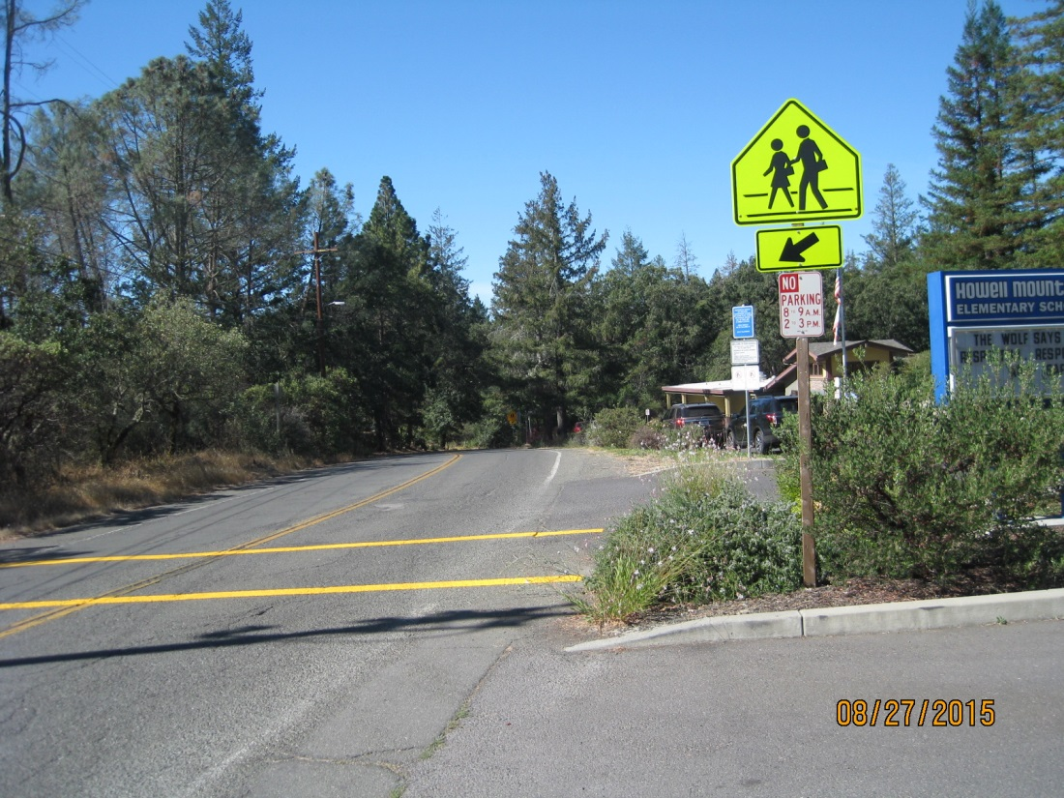
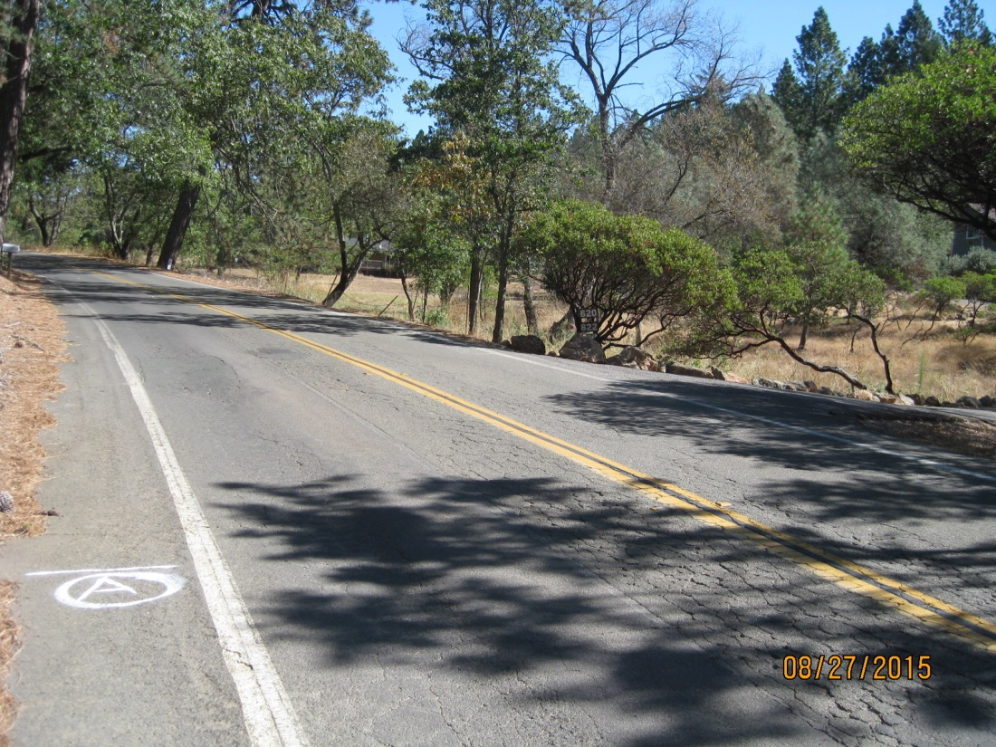
Walk Audit
Notes:
Existing conditions near elementary school

Slide 10
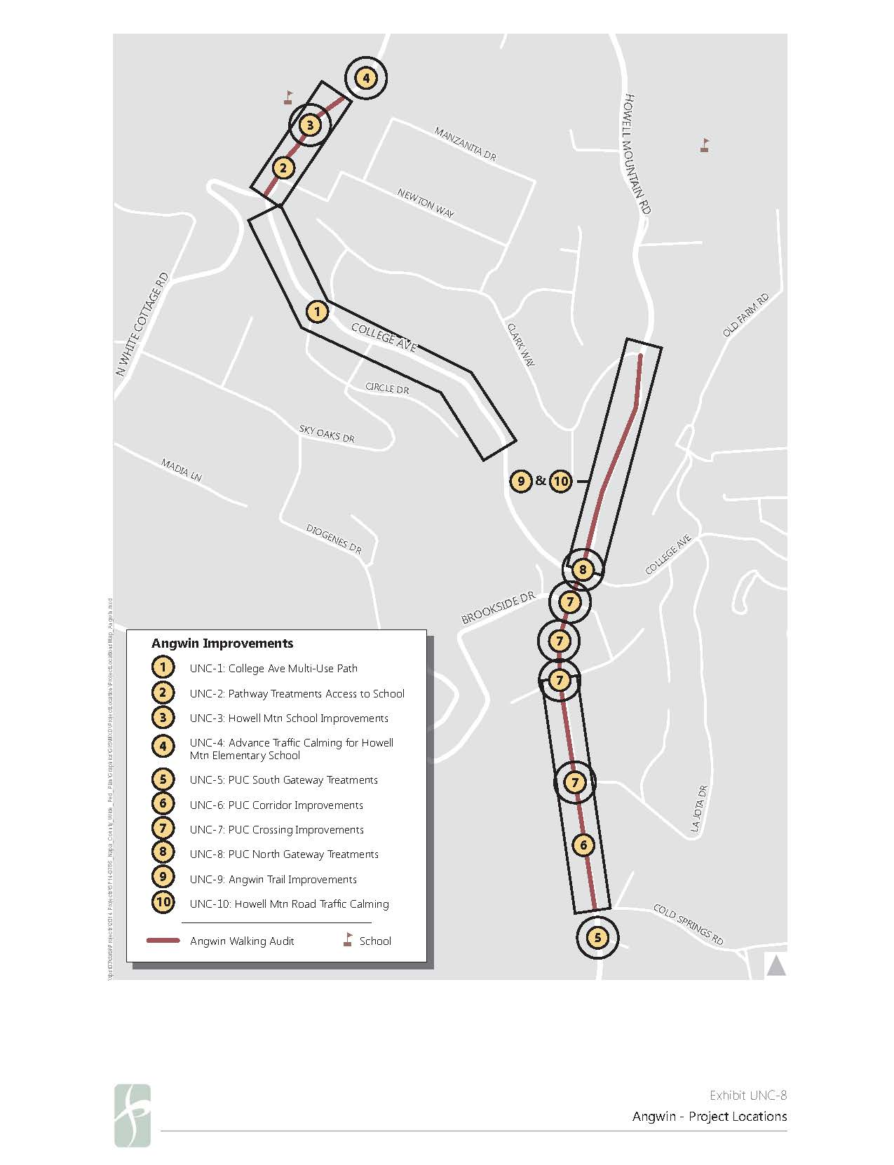
Notes:
Improvements
Path along College Avenue
Elementary school – crossings at 2 intersections, imprs along length of White Cottage here, and advance warning
College area – crossings at 4 intersections, 2 gateway treatments, imprs along length of Howell Mtn
Trail to Clark – improve trail, calm traffic on road
Projects are costed and prioritized

Slide 11

Implementation
Support Programs
  Safe Routes to School
  Monitoring
  Safety programs
Performance Goals
Notes:
Back to countywide level for wrap-up
SR2S = Education, Encouragement, Engineering, Enforcement, Evaluation
Count program – NVTA will do
Safety = “Vision Zero”
Performance metrics are organized around the Plan’s original goal statements
Provide network
Encourage walking
Coordinate with other activities (i.e., development review, road improvements)
Encourage and educate

Slide 12
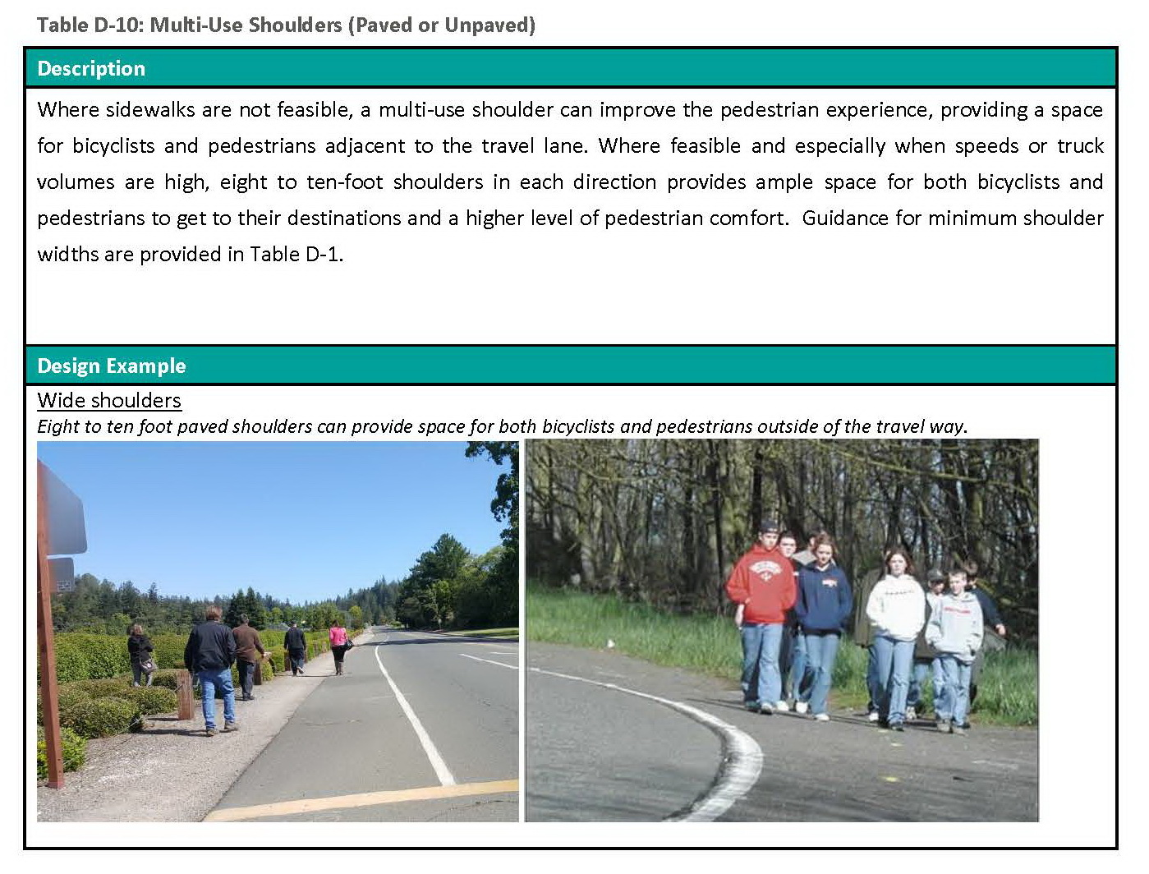
Best Practices
Notes:
Following are some especially applicable to unincorporated rural areas

Slide 13
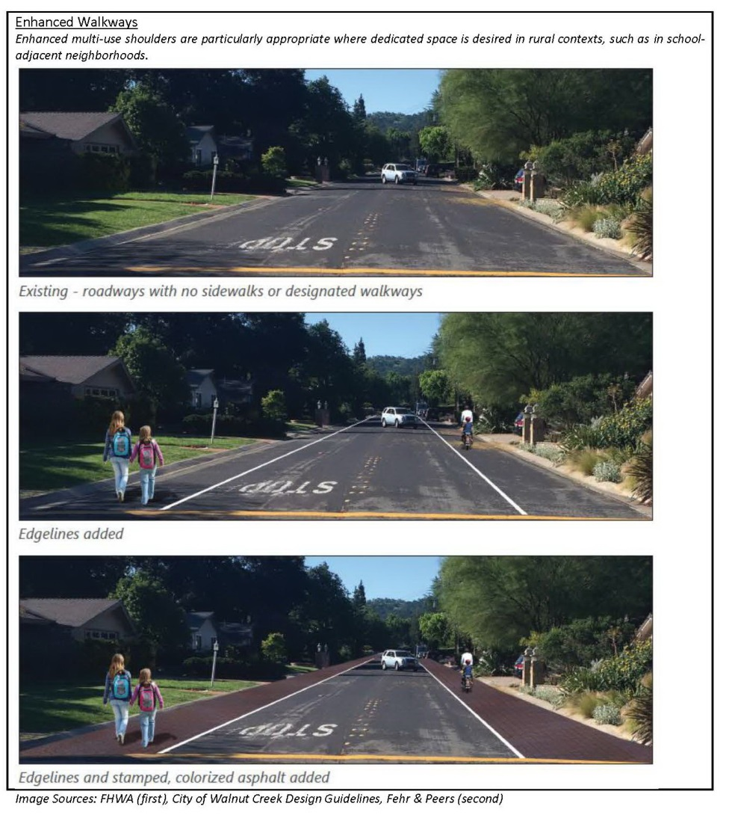
Best Practices

Slide 14
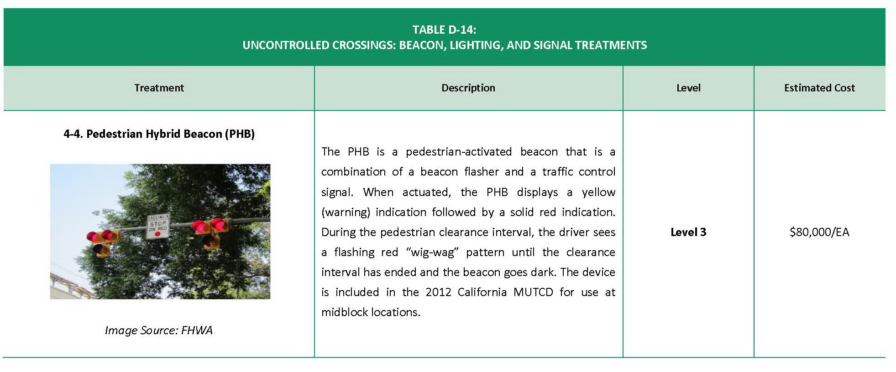
Best Practices
Notes:
This is being considered for Vine Trail crossing of SR 29/128 near Bothe Park

Slide 15
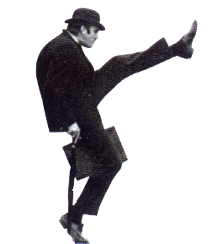
Questions?
Notes:
John Cleese just celebrated his 77th birthday. You’re welcome.

