Slide 1
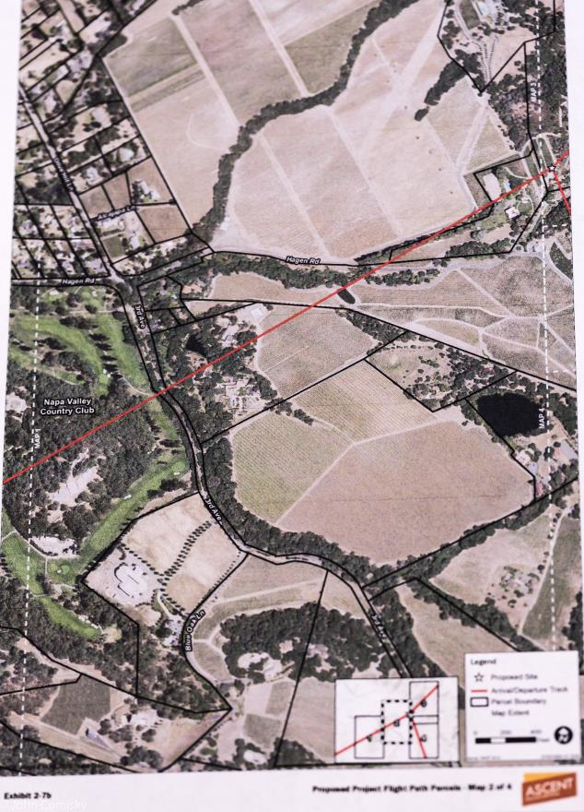
Hagen Road Heronry from Exhibit 2.7b from FEIR Project Updates

Slide 2
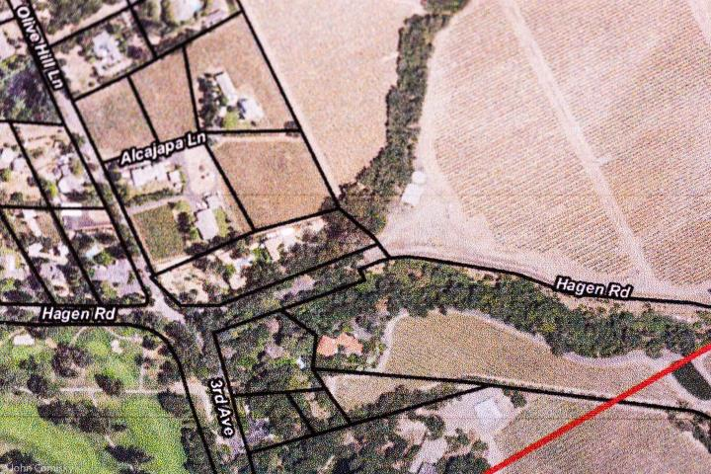
Hagen Road Heronry
Hagen Road Heronry
Approximately 800 FT
The Hagen Road Heronry is not addressed by the FEIR.
Nesting herons and egrets can be easily disturbed by human activity.
Disturbance sensitivity varies with stages of breeding (January – August).
Buffer zones of 300 – 700 feet are recommended based on a single human approaching on foot.
Helicopters are not single people on foot.

Slide 3
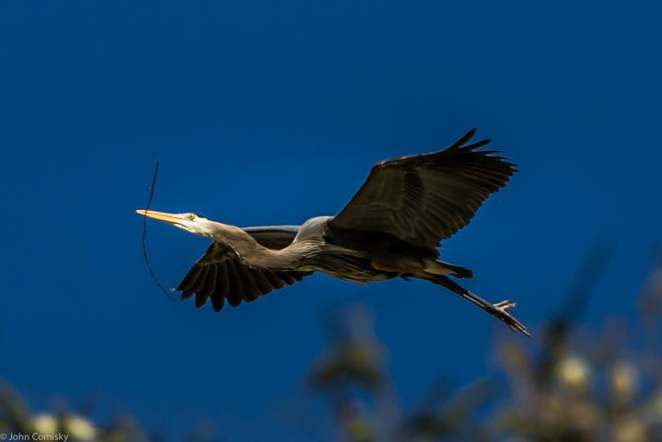
Incoming Heron flights to the Hagen Road Heronry have been observed to come from multiple directions and considerable distances.
Flight frequency varies with the stage of the breeding cycle, with individuals making multiple trips per day at the peak.
Buffer zones need to consider the full range of activity, not only the location of the heronry.

Slide 4
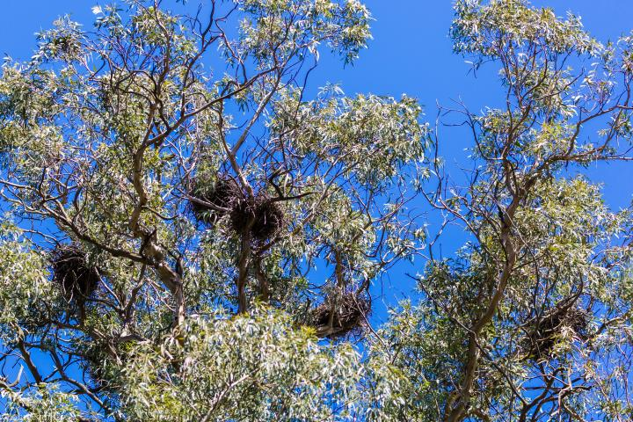
Study Point – Limited habitat for nesting birds at sites.
The Hagen Road Heronry has 12 – 15 nests within a single tree.
Each nest serves a breeding pair, with 2-4 chicks.
The Heronry has been occupied for over 40 years.
The adjacent tree has been the nesting site for Red-tailed hawks.

Slide 5
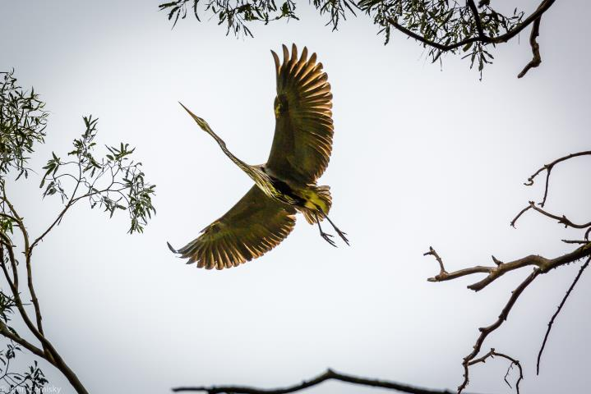
Study point - Helicopter operations would create noise disturbances similar to existing operations and maintenance conditions in the vineyard.
Multiple visits to the site have noted a low noise environment where approaching cars can be heard before they are visible. Vineyards are busy only at certain times. Harvest, one of the busy times, is at the end of breeding season.
Vineyards are on the ground, the nests are at 60-80 ft.
Helicopters by nature invade the air space, “the safety zone” of avian species, with noise, large body movement and the operative risk of strikes.

Slide 6
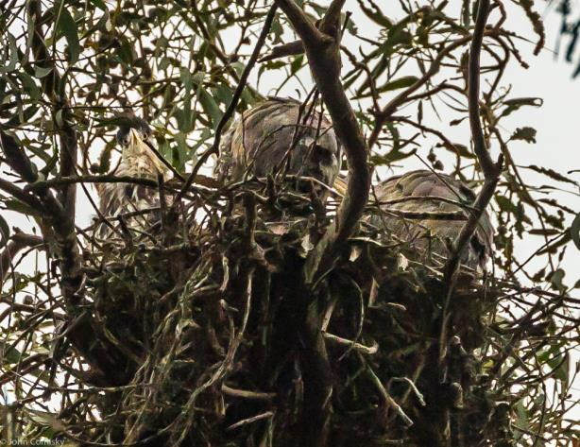
3 Great Blue Heron Chicks in a Nest (2016)
Study point - Potential adverse effects from construction and helicopter use on common migratory and non-migrator birds would not alone constitute a significant impact. Therefore, this issue is not discussed further in the DEIR.
Significance is a factor of scale.
Great Blue Herons are not an endangered species on the the whole, but the loss of the Hagen Road Heronry would be significant to the Napa population.
Conclusion:
The impact to the Hagen Road Heronry needs further study.

