Slide 1
Overflight and Noise Report
Palmaz Private Helipad
Ken Brody, MARCH 2017

Slide 2
Mead & Hunt Noise and Planning Experience
100’s of noise projects
  Master Plans
  Airport Land Use Compatibility Plans
  Part 150 Studies
Decades of experience
Nationwide Firm, Local Presence
  Santa Rosa Office
  Napa County Airport
  Hospital Heliports

Slide 3
Noise Analysis
Integrated Noise Model (INM)
  Not AEDT
INM Inputs
  Helicopter model (Bell 429)
  Operations – 4 flights (approach + departures) per week (conservative)
  Flight tracks
  Approach and departure profile
  Terrain
Modeled Multiple Tracks
  Investigated tracks that will have least impact on residences
Notes:
Not AEDT…
Started project well before AEDT was released.
For helicopters… modeling is the same in INM

Slide 4
Bell 429
State-of-the-art technology
Designed to:
  Improve performance and increase payload
  Maintain high safety margins
  Incorporate new noise reduction features into the design
ICAO International Civil Aviation Organization
  Helicopter Noise Reduction Technology Status Report (April, 21 2015)
FAA working to adopt the international standards for helicopters, which will be called Stage 3
Notes:
Talk about how aircraft are becoming quieter. Technology is making this so. Push by FAA and international agencies to make helicopters quieter. Trend will continue.
B429 is equipped with latest technology to help make the system quieter:
carbon fiber blades: providing enhanced performance and reduced noise
tail rotor is configured with four blades: a new design that helps improve performance while reducing noise
Source: ICAO International Civil Aviation Organization
Helicopter Noise Reduction Technology Status Report
21 April 2015

Slide 5
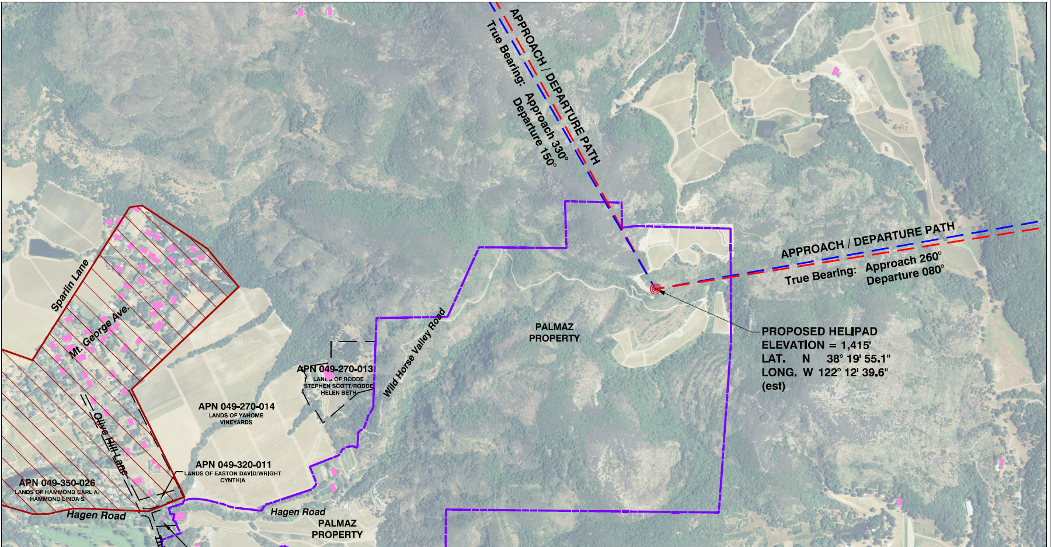
Proposed Flight Tracks
To / From East
To / From Northwest
Notes:
where does Mr Palmaz expect to mostly fly to/from? What would be his route to/from Napa Airport?
- questions for Mr Palmaz.
I believe back n forth to Tahoe and Plumas and SMF. Maybe SFO
I think saying he will fly back n forth to APC is not a positive for this project.
Flight tracks were proposed that will take advantage of prevailing winds and terrain, while eliminating direct overflight of nearby residences. The flight tracks presented will be followed when weather conditions permit. Palmaz will also avoid flying over residences, below 1,000 feet above ground level, whenever possible.

Slide 6
Fly Neighborly
No Fly Zone
Approach / Departure Paths Over Uninhabited Areas
Flights at 1,500 Feet Above Ground Level
Steeper Approach and Departure Profiles
Notes:
proposed pad is 1400 ft above valley floor

Slide 7
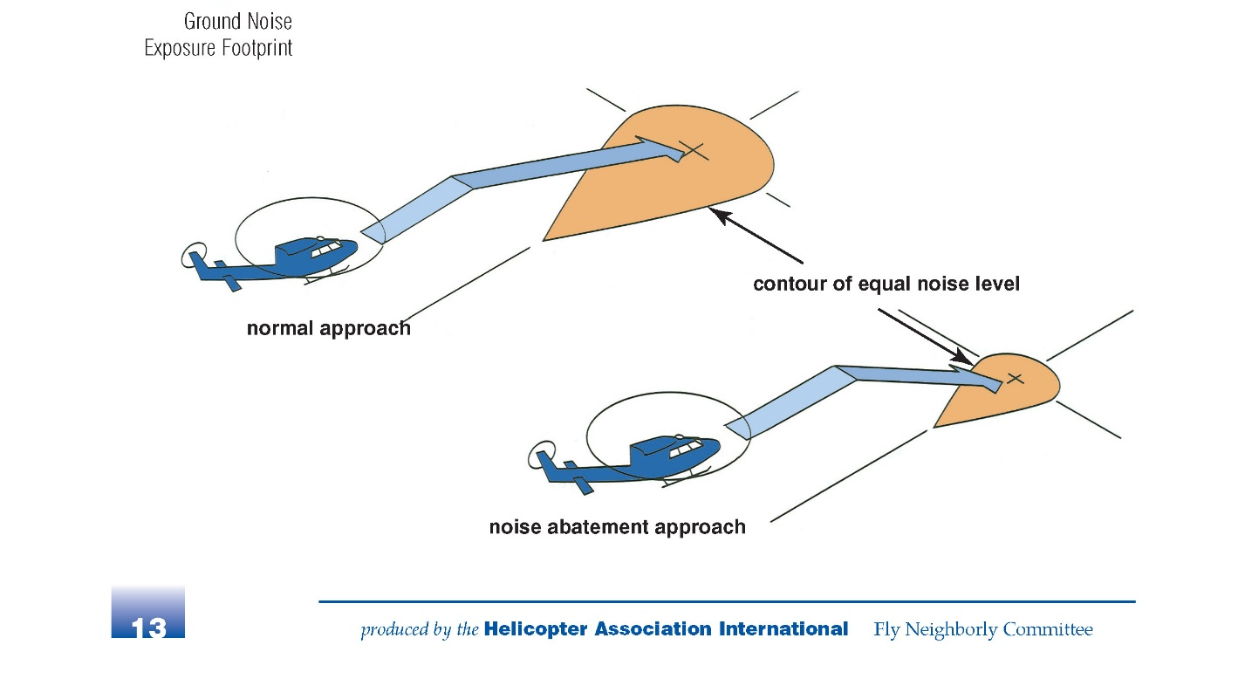
Operating Profile
Standard Approach / Departure
Helicopter Association International Recommendation

Slide 8
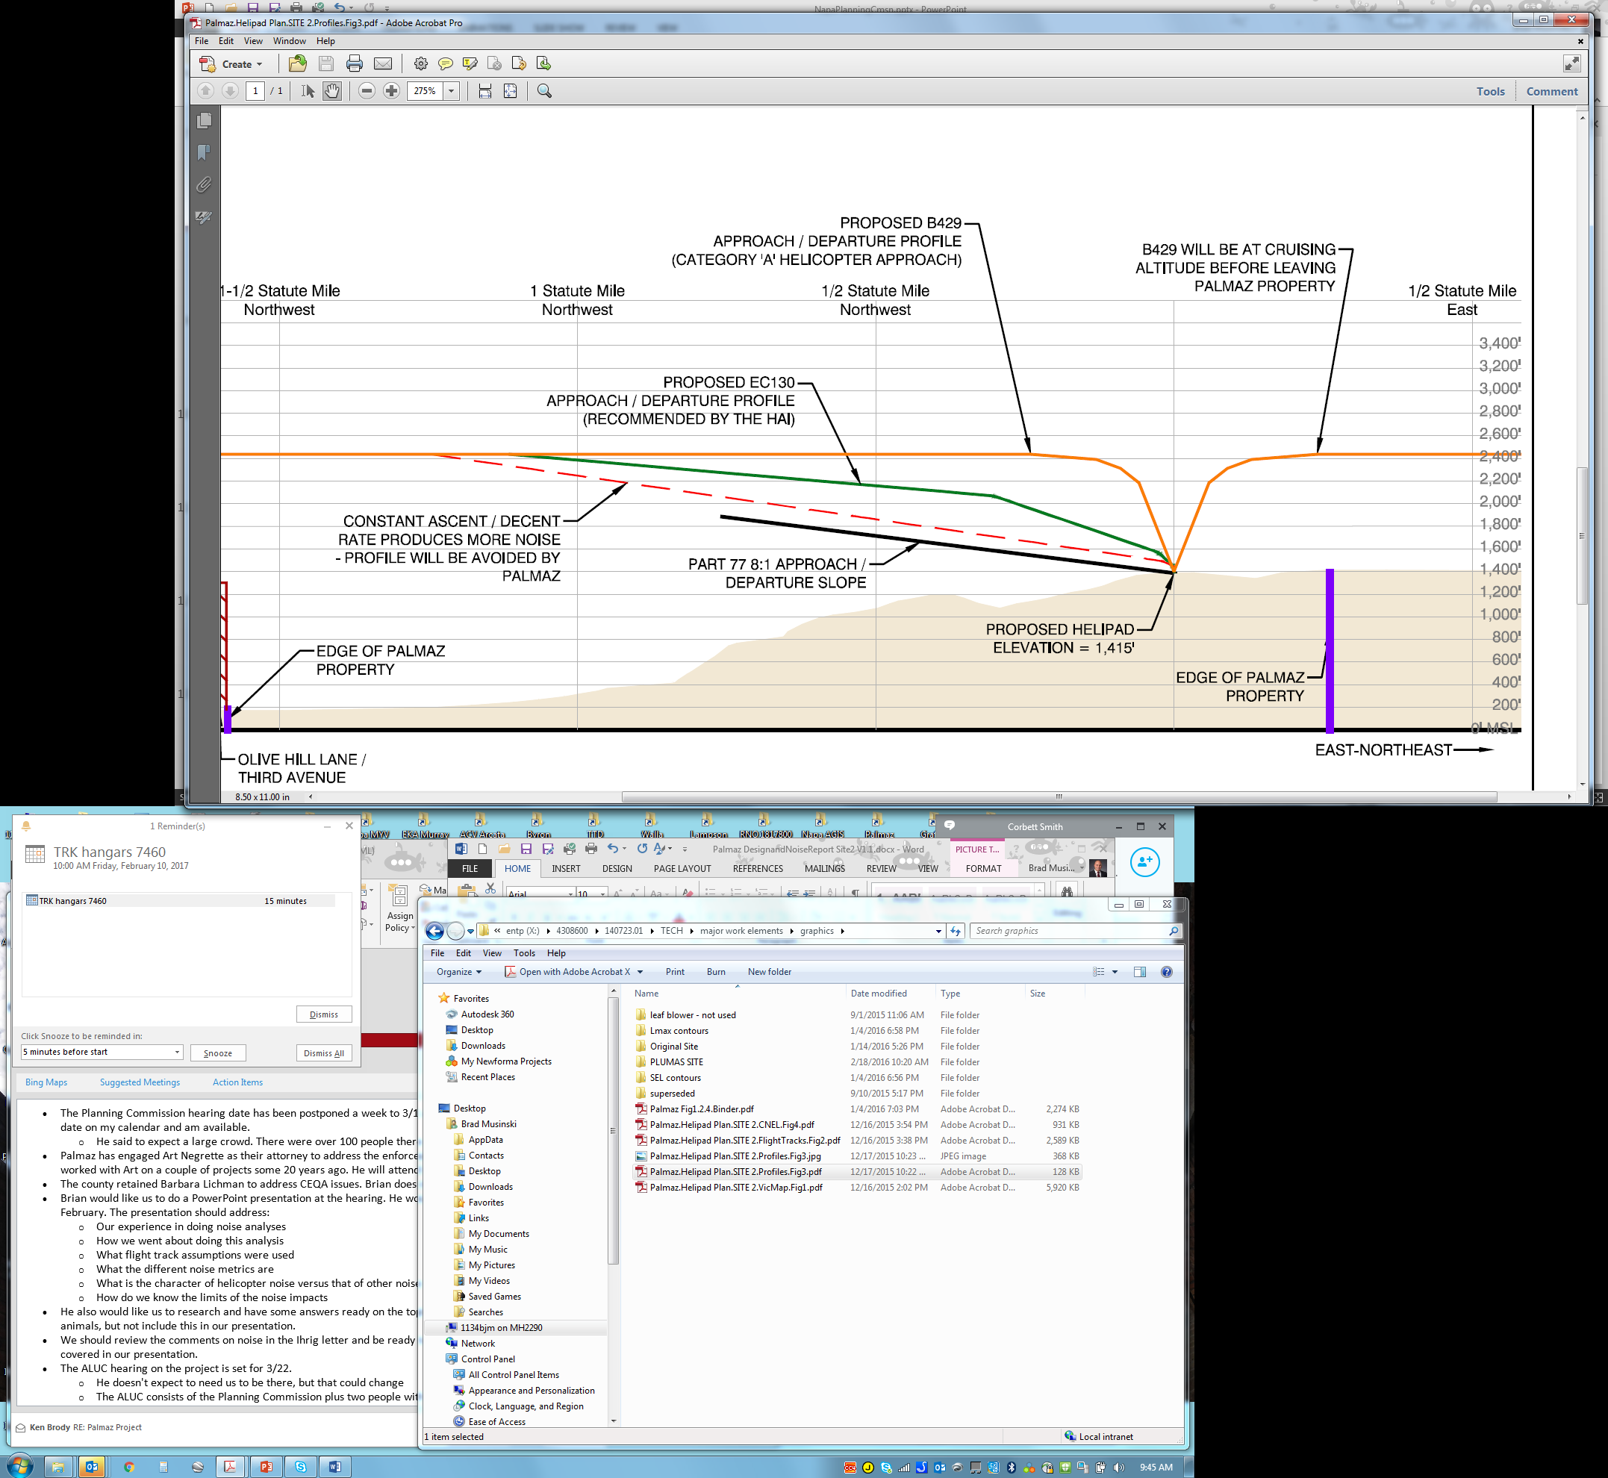
Operating Profile
Notes:
Emphasize again that his approach / departure profiles are steeper than typical /recommended profiles. Results in helicopter reaching cruising altitude quicker and leaving area quicker – thus less noise impacts.
This was modeled in INM.

Slide 9
Thank You

